Slide 1
Keep Your
Church
Out of Court

Slide 2
Introduction
TAB 1 – Legal Summary
*This notebook and seminar does NOT constitute legal advice.
Our Goal:
Provide an overview of important legal issues and litigation risks.
Summarize the top 5 reasons churches go to court.
Consider 5 key areas for mitigating lawsuit risk.
Provide resources for more information.

Slide 3
Introduction
TAB 1 – Legal Summary
*This notebook and seminar does NOT constitute legal advice.
Notebook Outline:
Organized by key areas of law/litigation
TAB 1 – Seminar Outline (PULL THIS OUT)
1½ hour overview of general church legal issues

Slide 4
Introduction
TAB 1 – Legal Summary
*This notebook and seminar does NOT constitute legal advice.
Administration and Law
Recognize that administration exists to facilitate:
Ministry
Gospel Impact
The Great Commission
The law is just another tool to facilitate
effective ministry.

Slide 5
Introduction
TAB 1 – Legal Summary
*This notebook and seminar does NOT constitute legal advice.
Administration and Law
Quick Illustration:
In the 2025-26 First West See To It Budget,
Personnel, Debt Service and Facilities represent a large portion of total expenses.
This is among the reasons why getting
these matters right is so important.

Slide 6
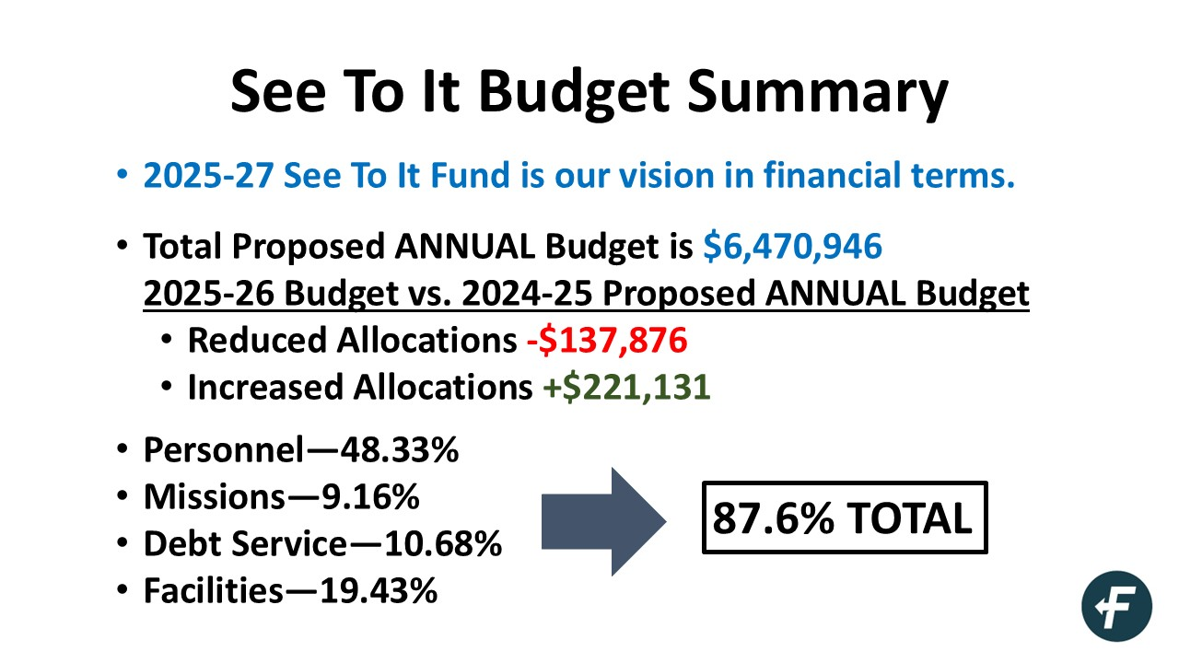

Slide 7
Legal Summary
TAB 1 – “Church Legal Matters Overview”
by Michael Best
Corporate (Transactions & Governance) – pp. 1-2
501(c)(3) Subsidiaries —
Governance, Boards, Property, Tax IDs
Corporate Governance Structure —
How are important decisions made?
The proper roles of Pastor, Staff, Deacons, Committees, and Trustees are typically defined here.
Follow your governing documents. Not following those documents may constitute grounds for litigation.

Slide 8
Legal Summary
TAB 1 – “Church Legal Matters Overview”
by Michael Best
Corporate (Transactions & Governance) – pp. 1-2
Marriage/Gender Identity Views —
Doctrinal Statements are foundational, but may not be enough.
Answer the questions: Who can be married at my church? What kinds of marriages may pastors at my church officiate?
Marriage Definition
Other Factors — Counseling, Covenant Marriage
Waivers of Liability —
It's important to recognize that lawsuits can occur at any time and for any reason.
Waivers simply mitigate risk and deter potential lawsuits.

Slide 9
Legal Summary
TAB 1 – “Church Legal Matters Overview”
by Michael Best
Corporate (Transactions & Governance) – pp. 1-2
Membership —
Because church membership typically confers special privileges, it is an important milestone.
In most churches, members can: Serve in leadership, serve on committees, become a deacon, have a marriage ceremony, vote on church business, etc.
Answer the question: Who can become a member?
Church Discipline

Slide 10
Legal Summary
TAB 1 – “Church Legal Matters Overview”
by Michael Best
Commercial Real Estate – p. 2
Real Estate Transactions
Land Use and Zoning
Intellectual Property – pp. 2-3
Licensing (CCLI/CVLI)
Streaming and Social Media Content
Data Privacy and Data Breaches

Slide 11
Legal Summary
TAB 1 – “Church Legal Matters Overview”
by Michael Best
Employment Law – pp. 3-5
Personnel Policy and Handbook
Employee Classification —
FLSA Classification Tree for Churches and Other Religious Organizations* (1 page)

Slide 12
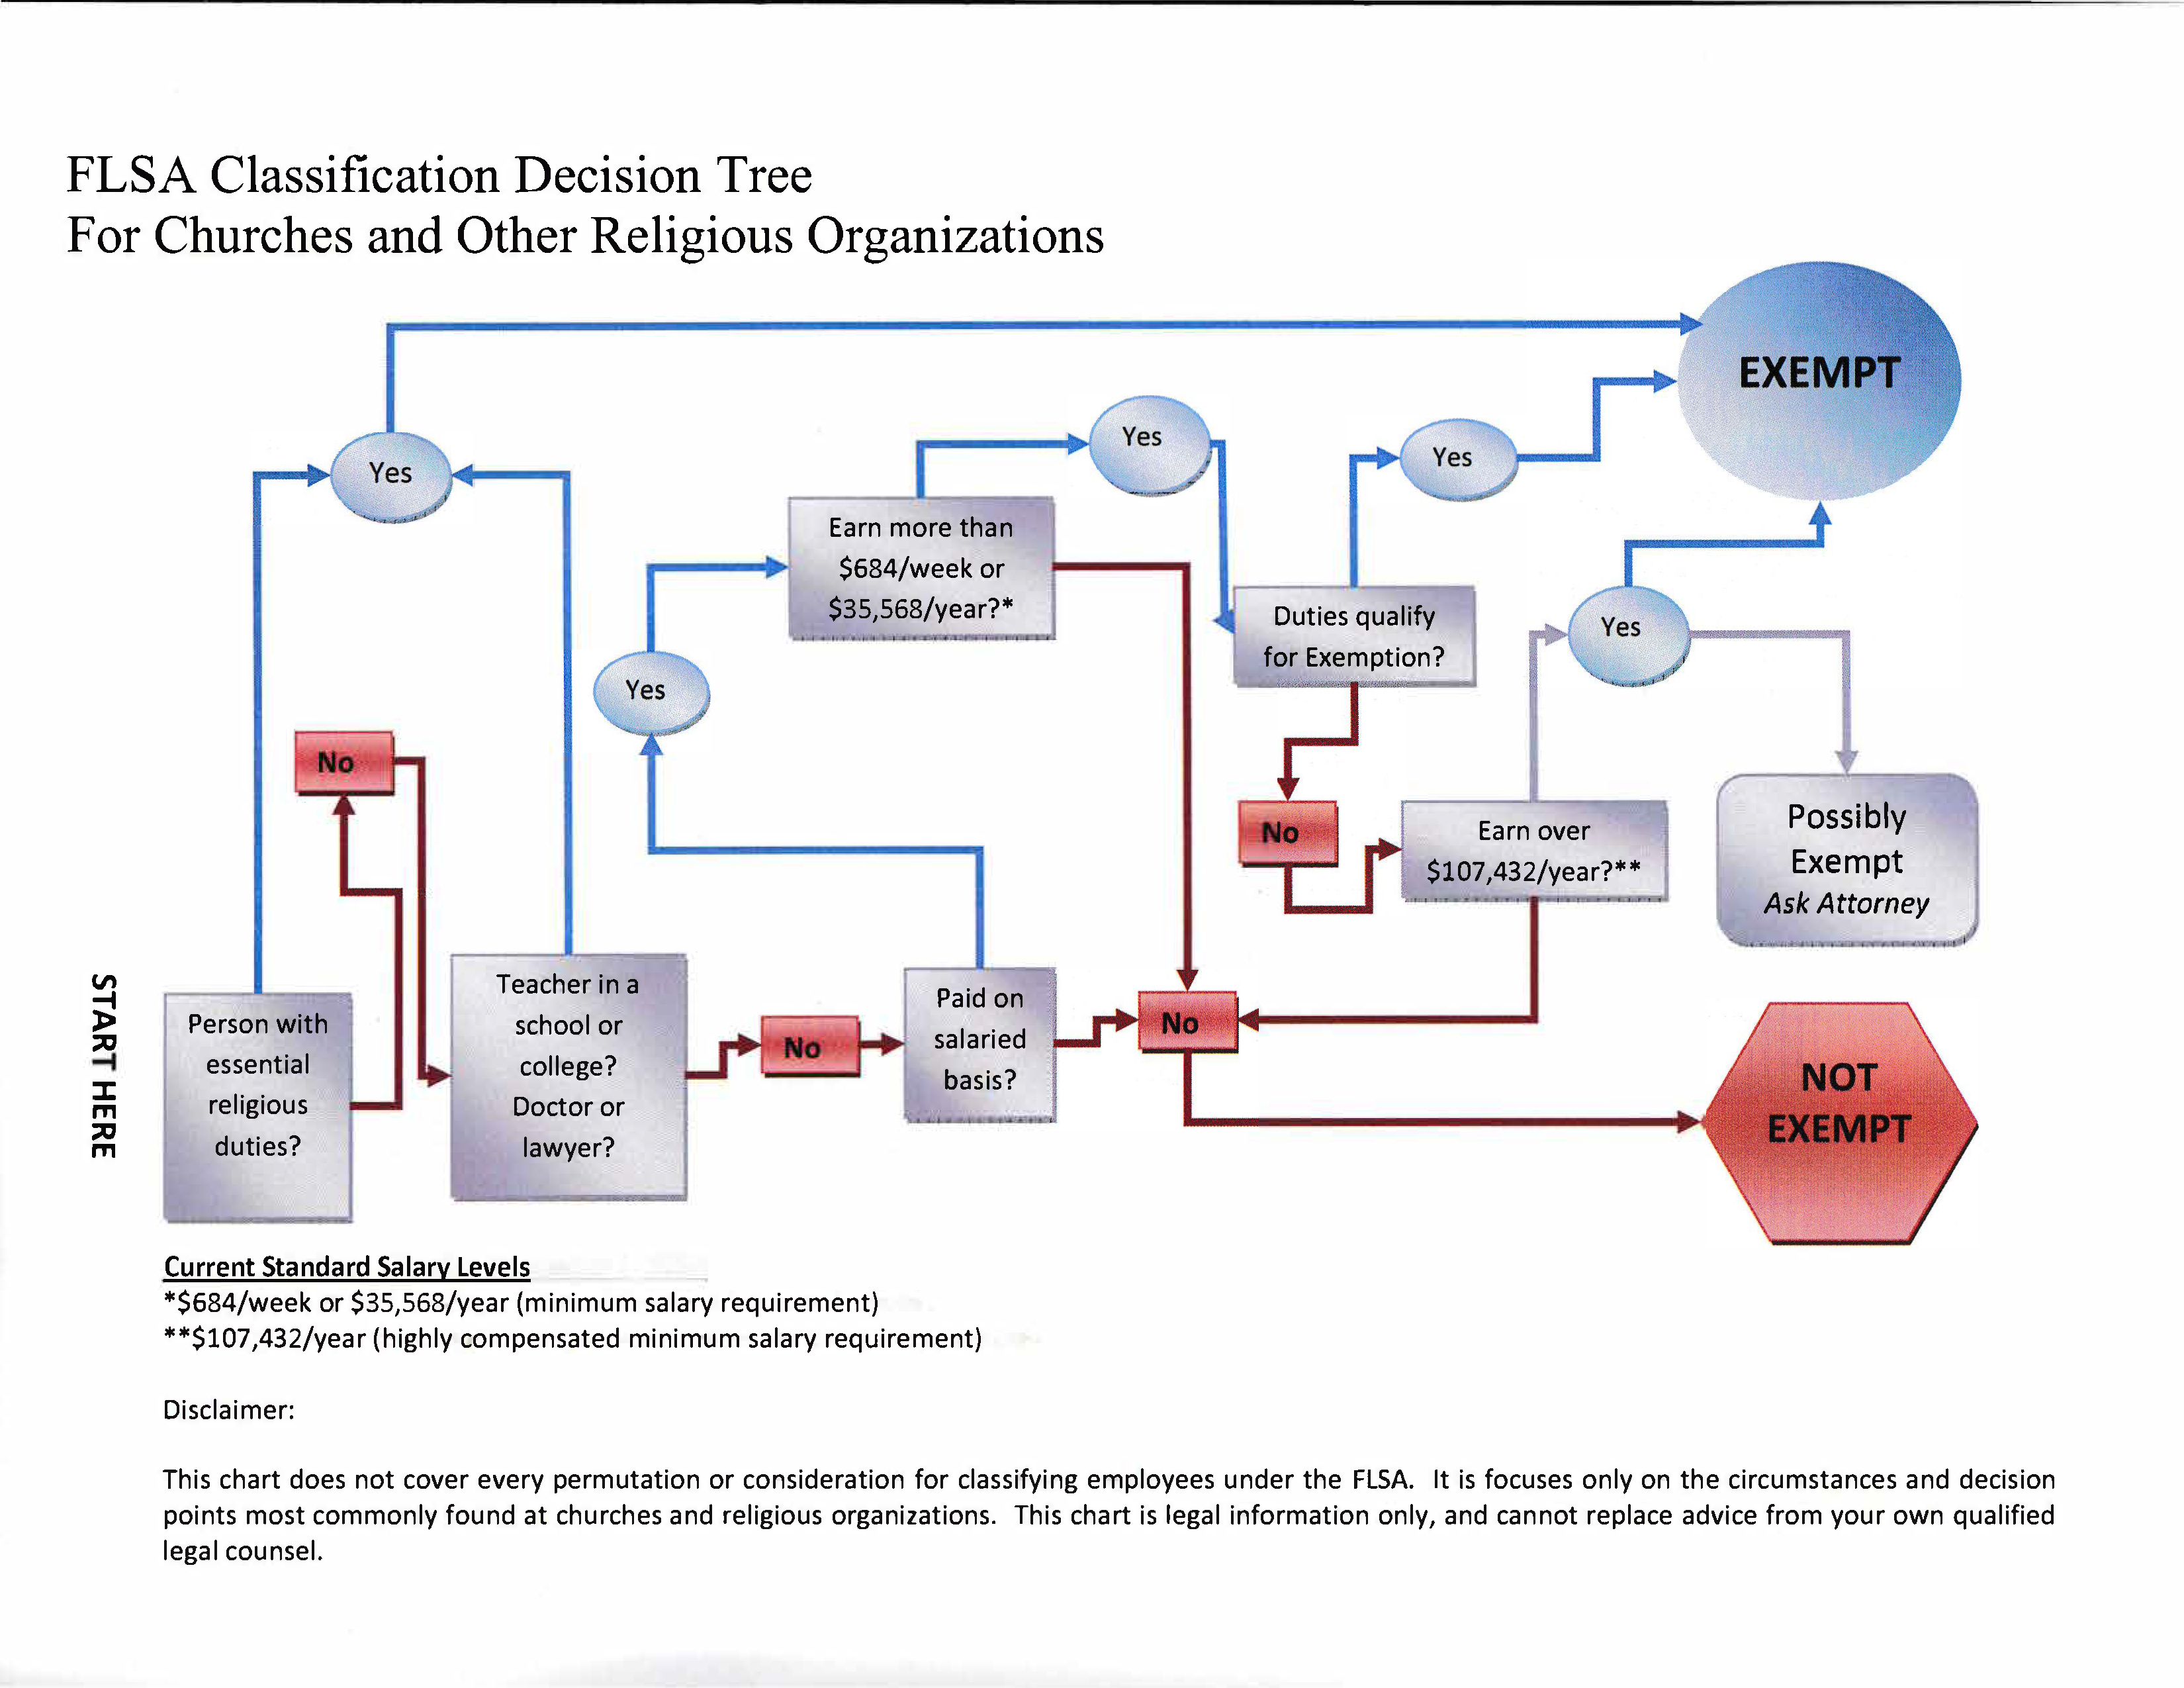

Slide 13
Legal Summary
TAB 1 – “Church Legal Matters Overview”
by Michael Best
Employment Law – pp. 3-5
Personnel Policy and Handbook
Employee Classification —
FLSA Classification Tree for Churches and Other Religious Organizations* (1 page)
Licensing, Ordination, Commissioning* (1 page)
Ministerial Recognitions Q&A* (2 pages)

Slide 14
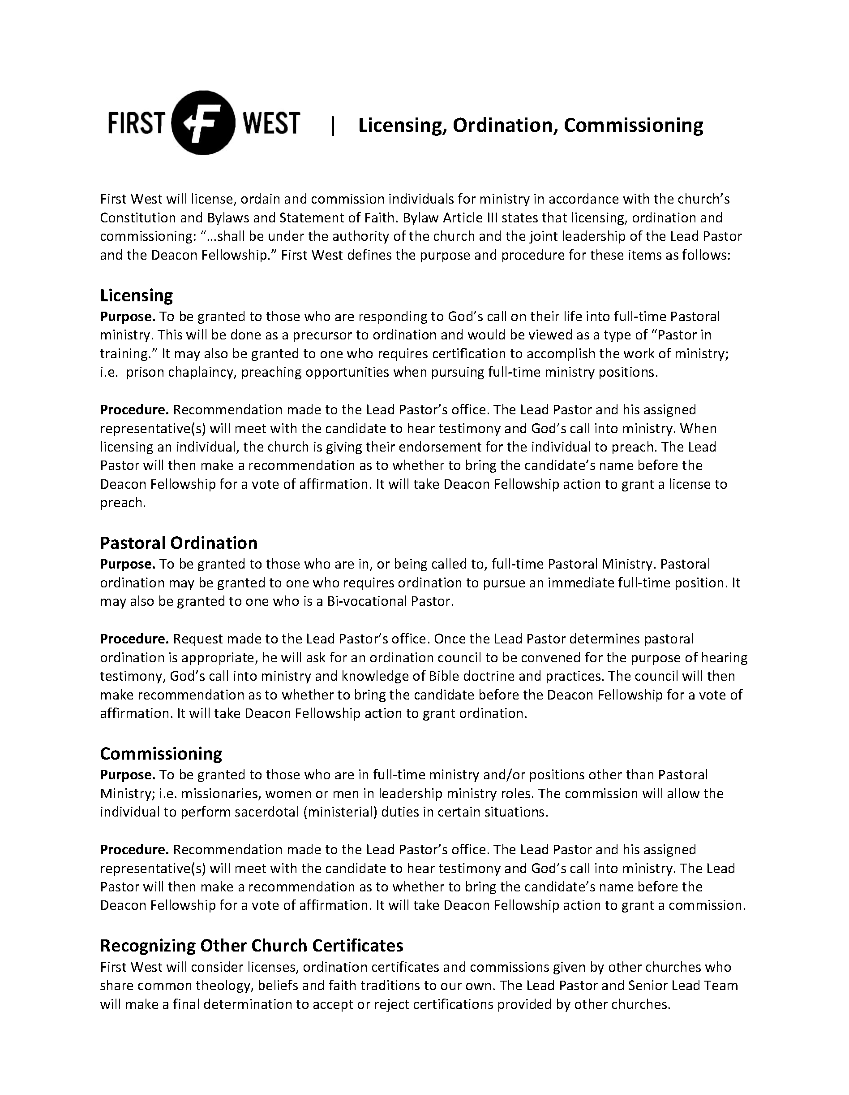

Slide 15
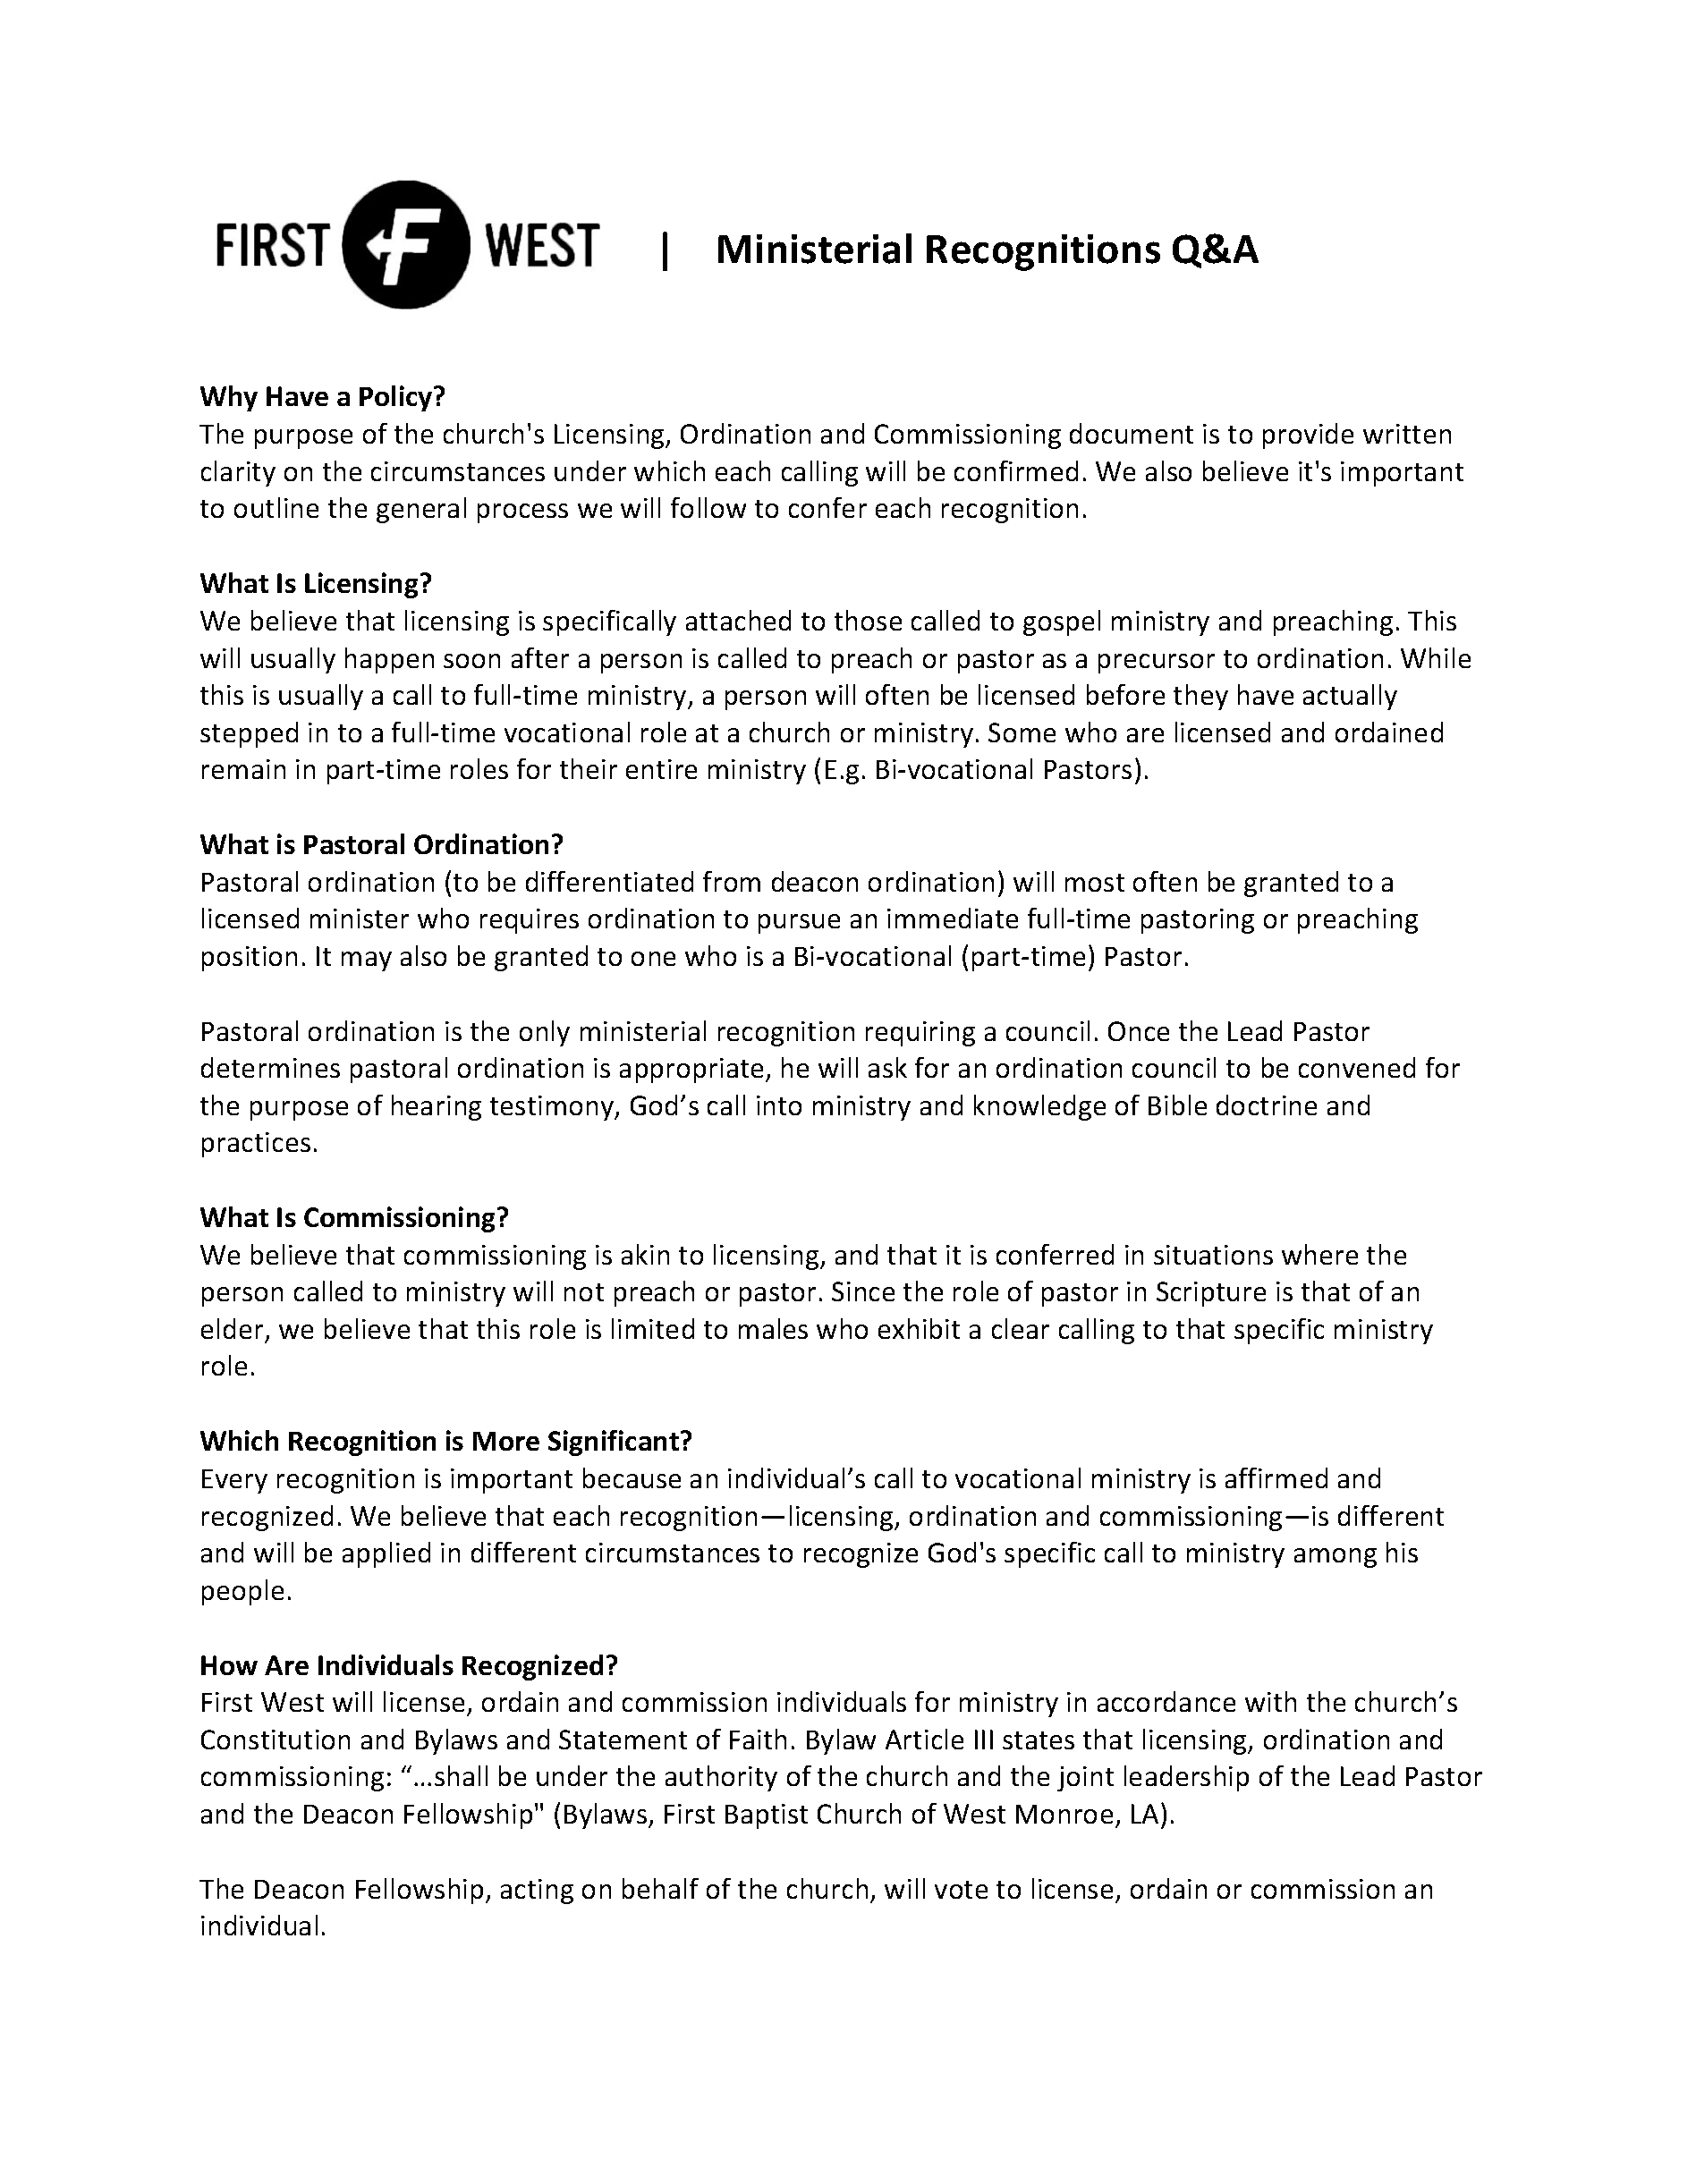

Slide 16
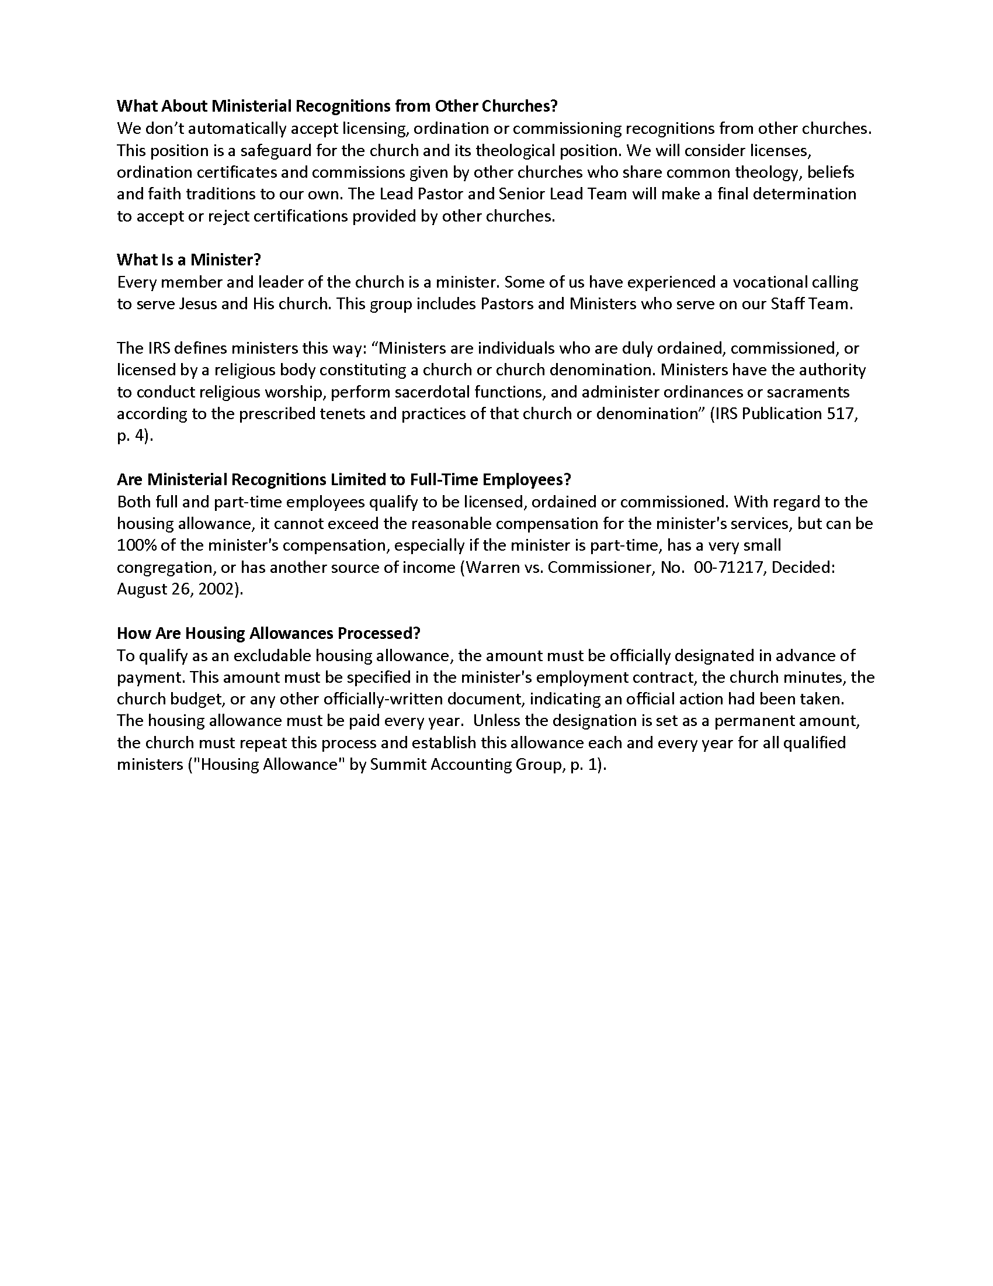

Slide 17
Legal Summary
TAB 1 – “Church Legal Matters Overview”
by Michael Best
Employment Law – pp. 3-5
Personnel Policy and Handbook
Employee Classification —
FLSA Classification Tree for Churches and Other Religious Organizations* (1 page)
Licensing, Ordination, Commissioning* (1 page)
Ministerial Recognitions Q&A* (2 pages)
Background Checks and Drug Screenings
Housing Allowances — Handout* (1 page)

Slide 18
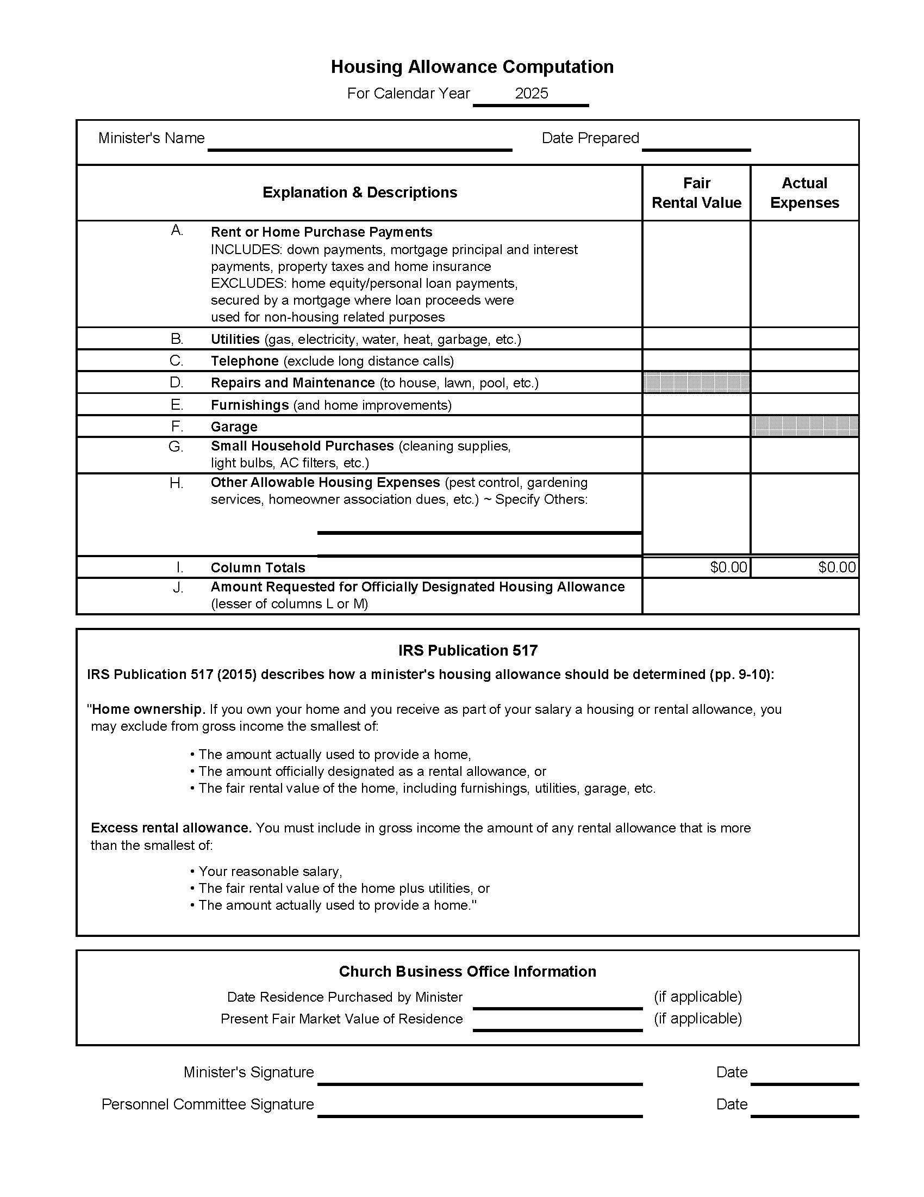

Slide 20
Legal Summary
TAB 1 – “Church Legal Matters Overview”
by Michael Best
Employment Law – pp. 3-5
Personnel Policy and Handbook
Employee Classification —
FLSA Classification Tree for Churches and Other Religious Organizations* (1 page)
Licensing, Ordination, Commissioning* (1 page)
Ministerial Recognitions Q&A* (2 pages)
Background Checks and Drug Screenings
Housing Allowances — Handout* (1 page)
Residency Program and Interns
Fact Sheet #71 (Department of Labor) – Handout* (1 page)

Slide 21
Legal Summary
TAB 1 – “Church Legal Matters Overview”
by Michael Best
Other General Legal Issues – pp. 5-7
Financial Policy
Church Discipline
Security and Safety

Slide 22
Reasons Churches Go to Court
TAB 2 – “The Top 5 Reasons Churches and Religious Organizations Go to Court”
by Church Law & Tax
The Sexual Abuse of a Minor (Tab 3)
Property Disputes
Personal Injury (Tab 4)
Zoning
Insurance Coverage Disputes (Tab 5)

Slide 23
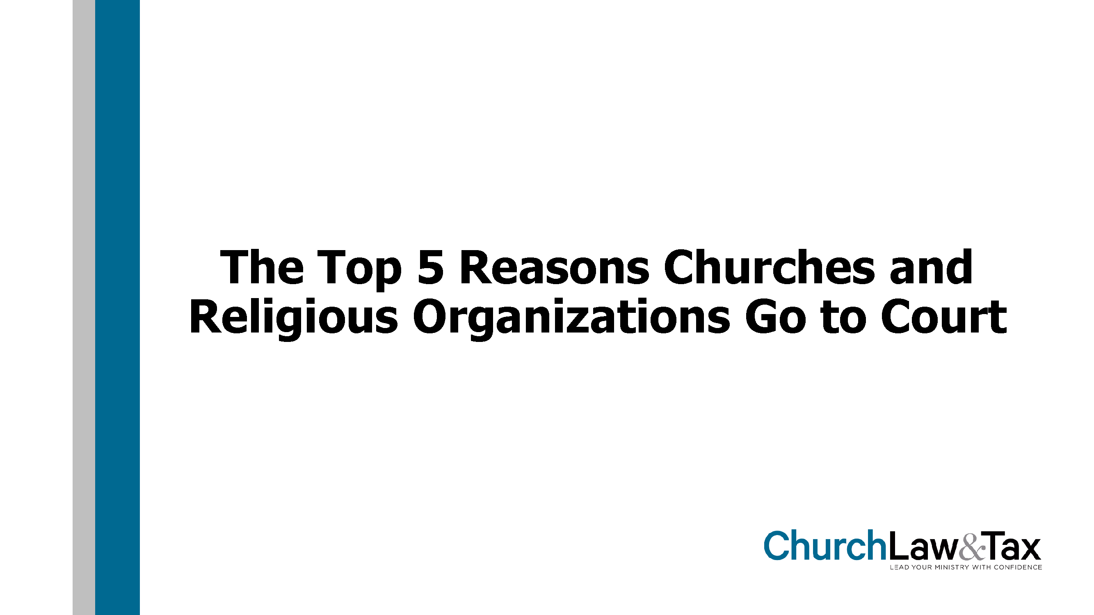

Slide 24
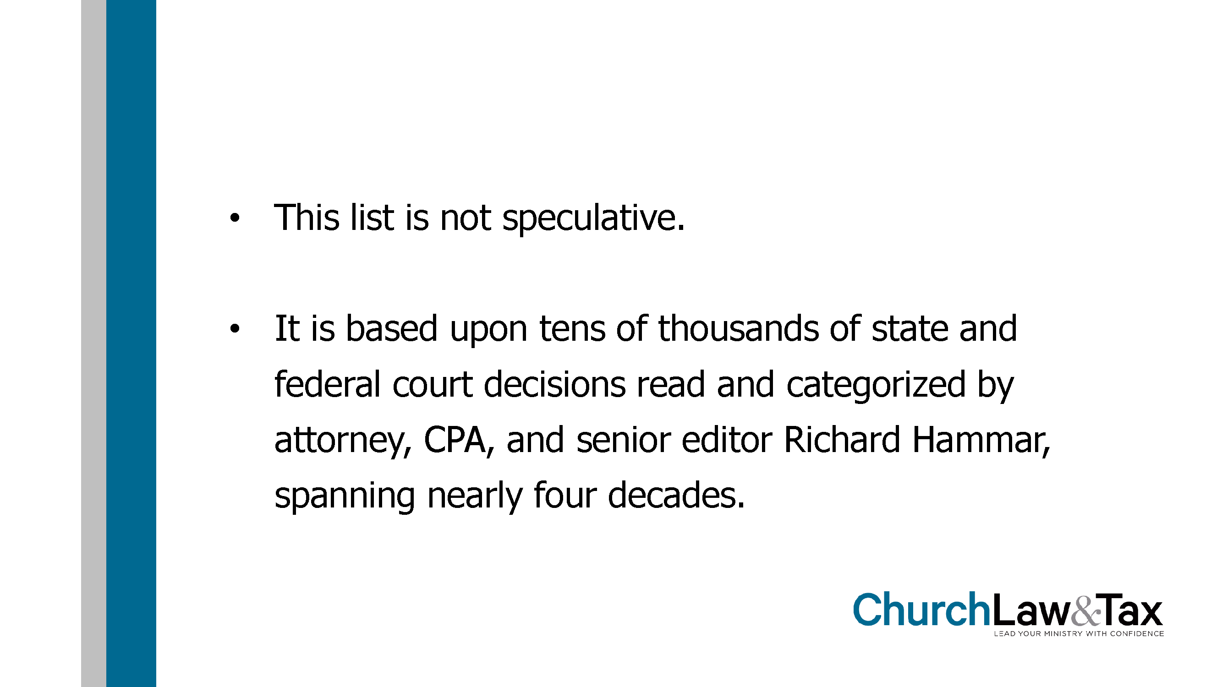

Slide 25
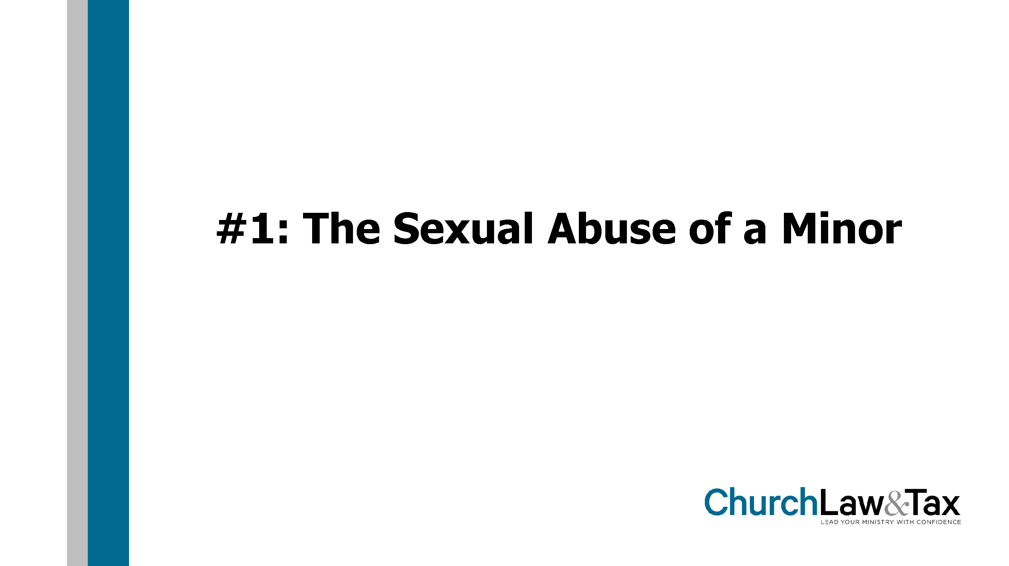

Slide 26
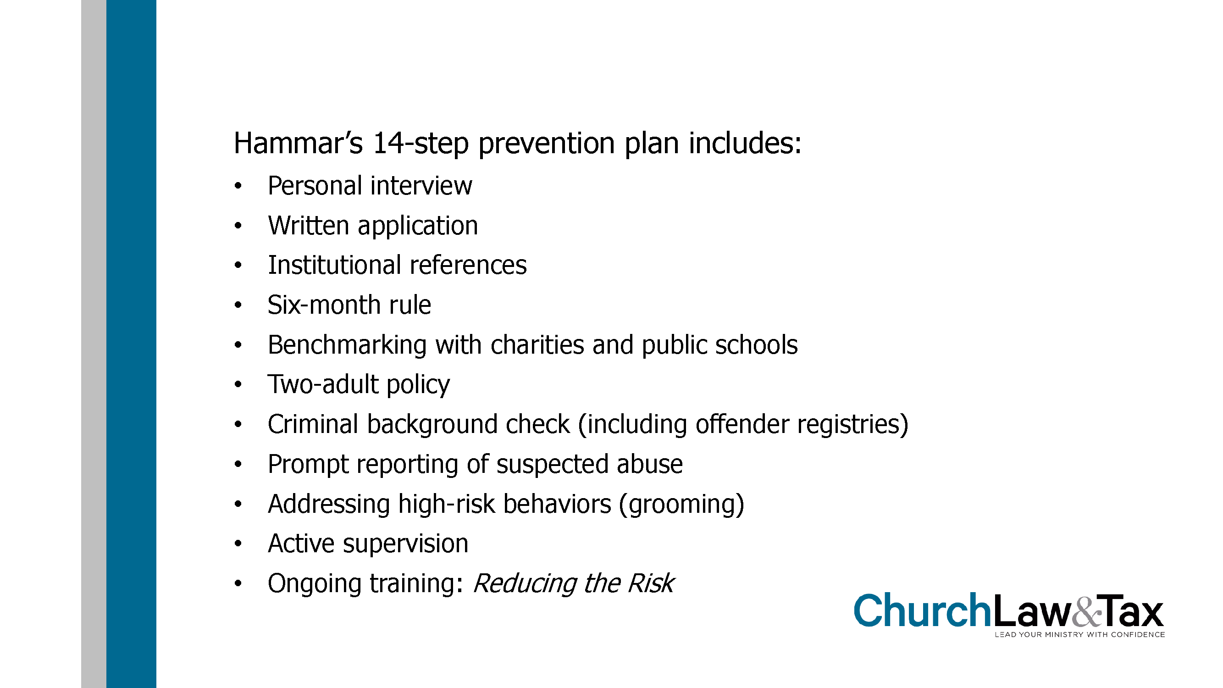

Slide 27
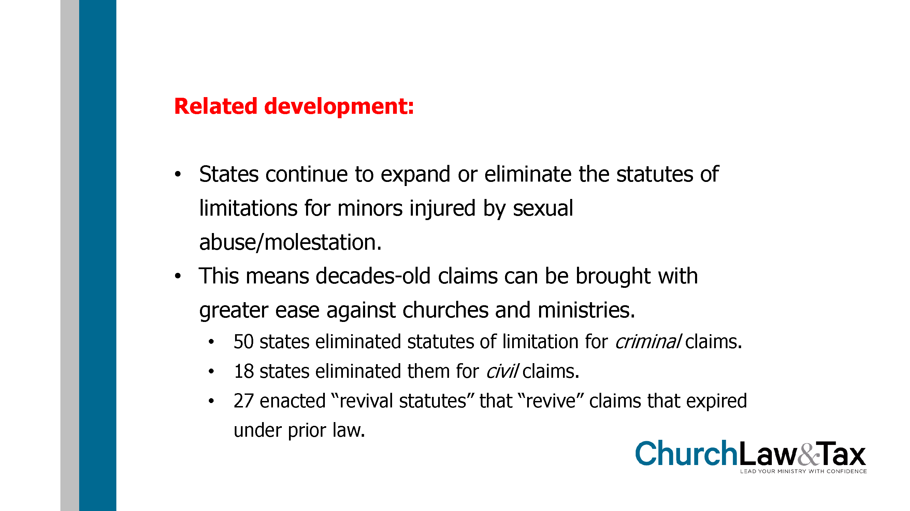

Slide 28
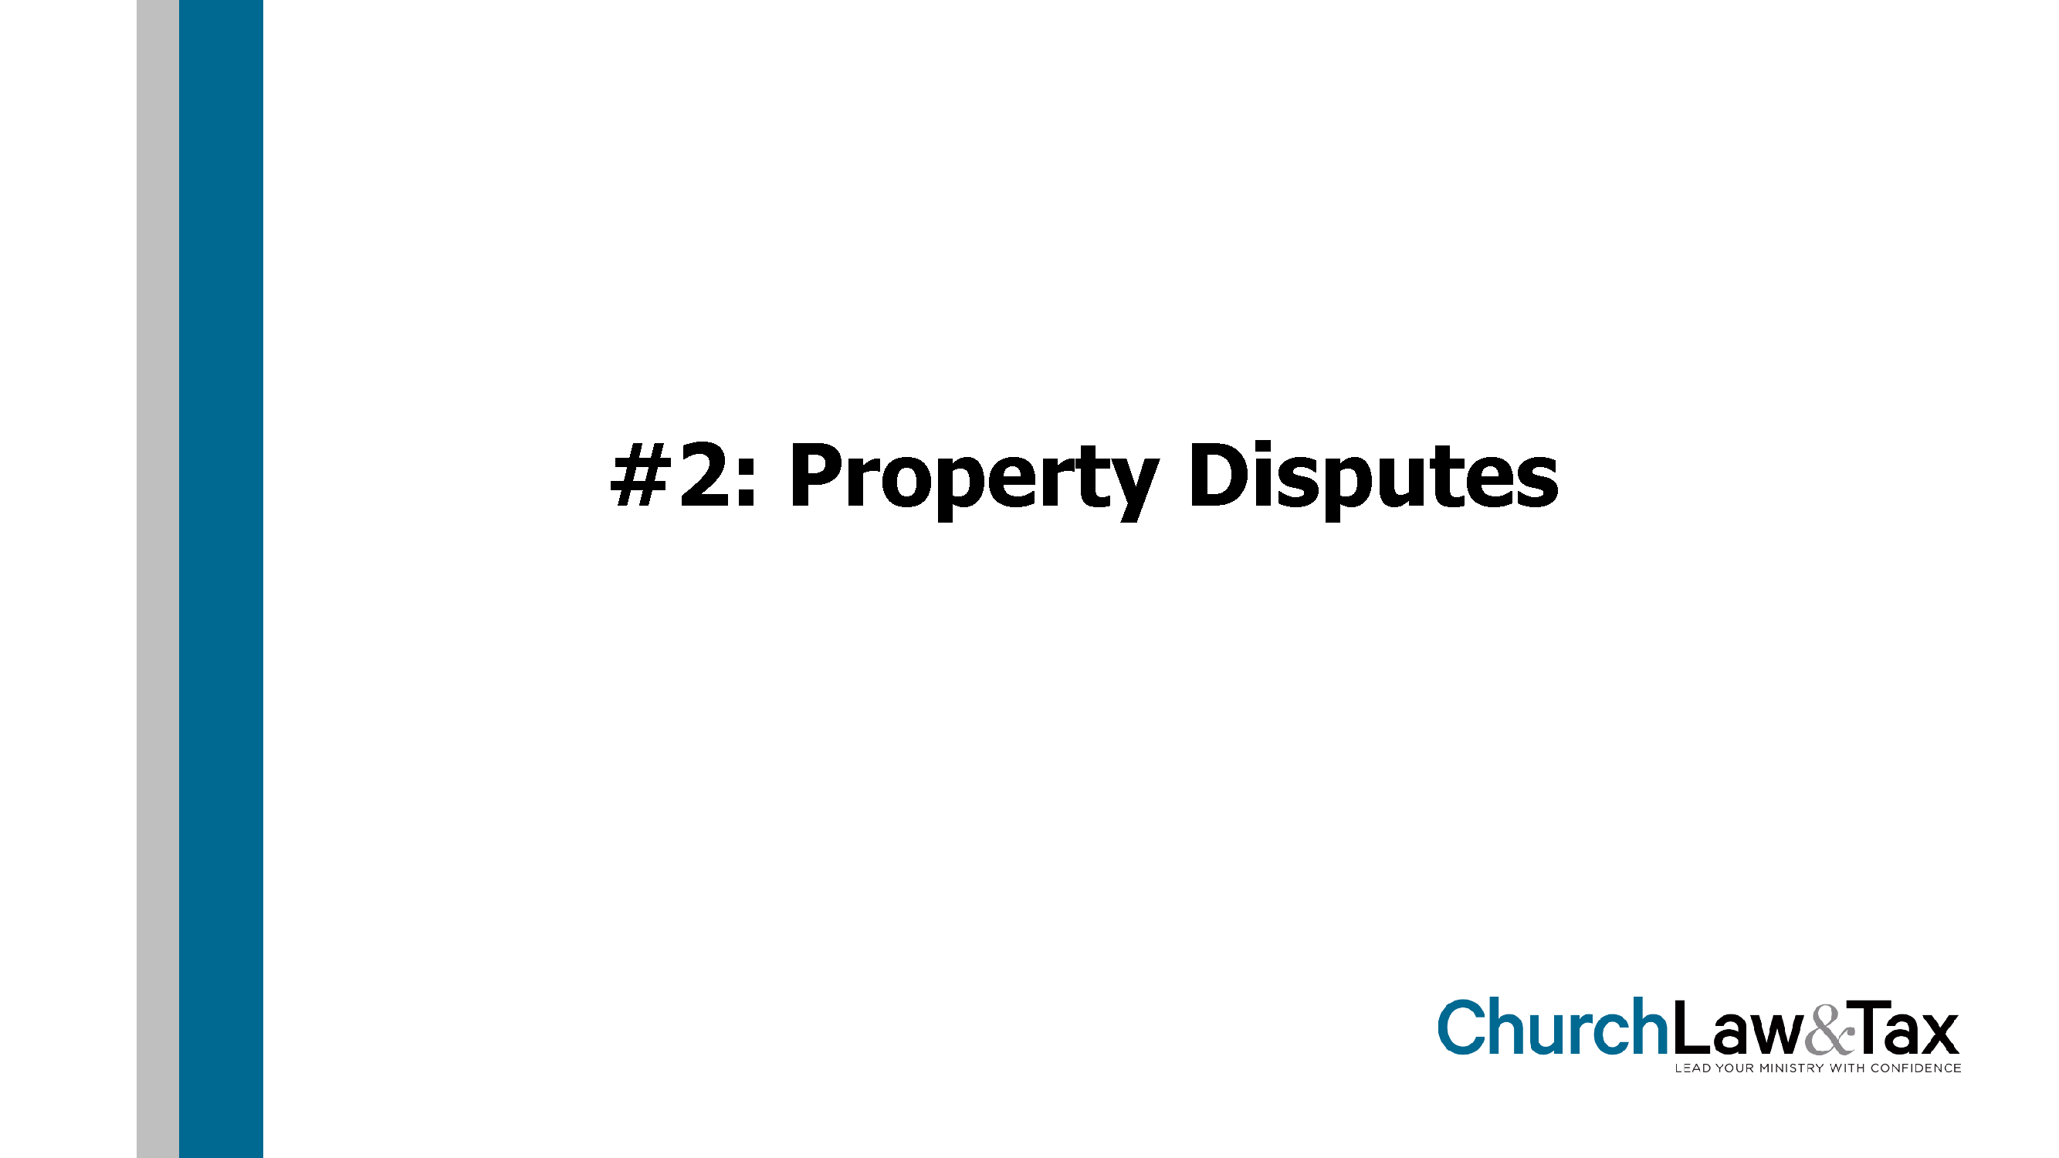

Slide 29
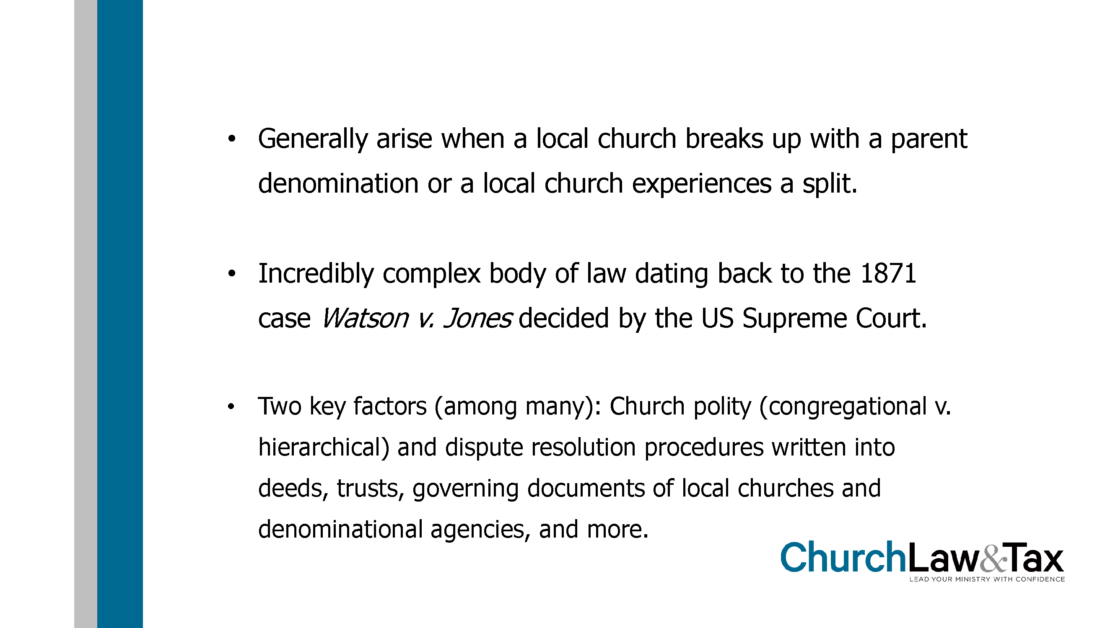

Slide 30
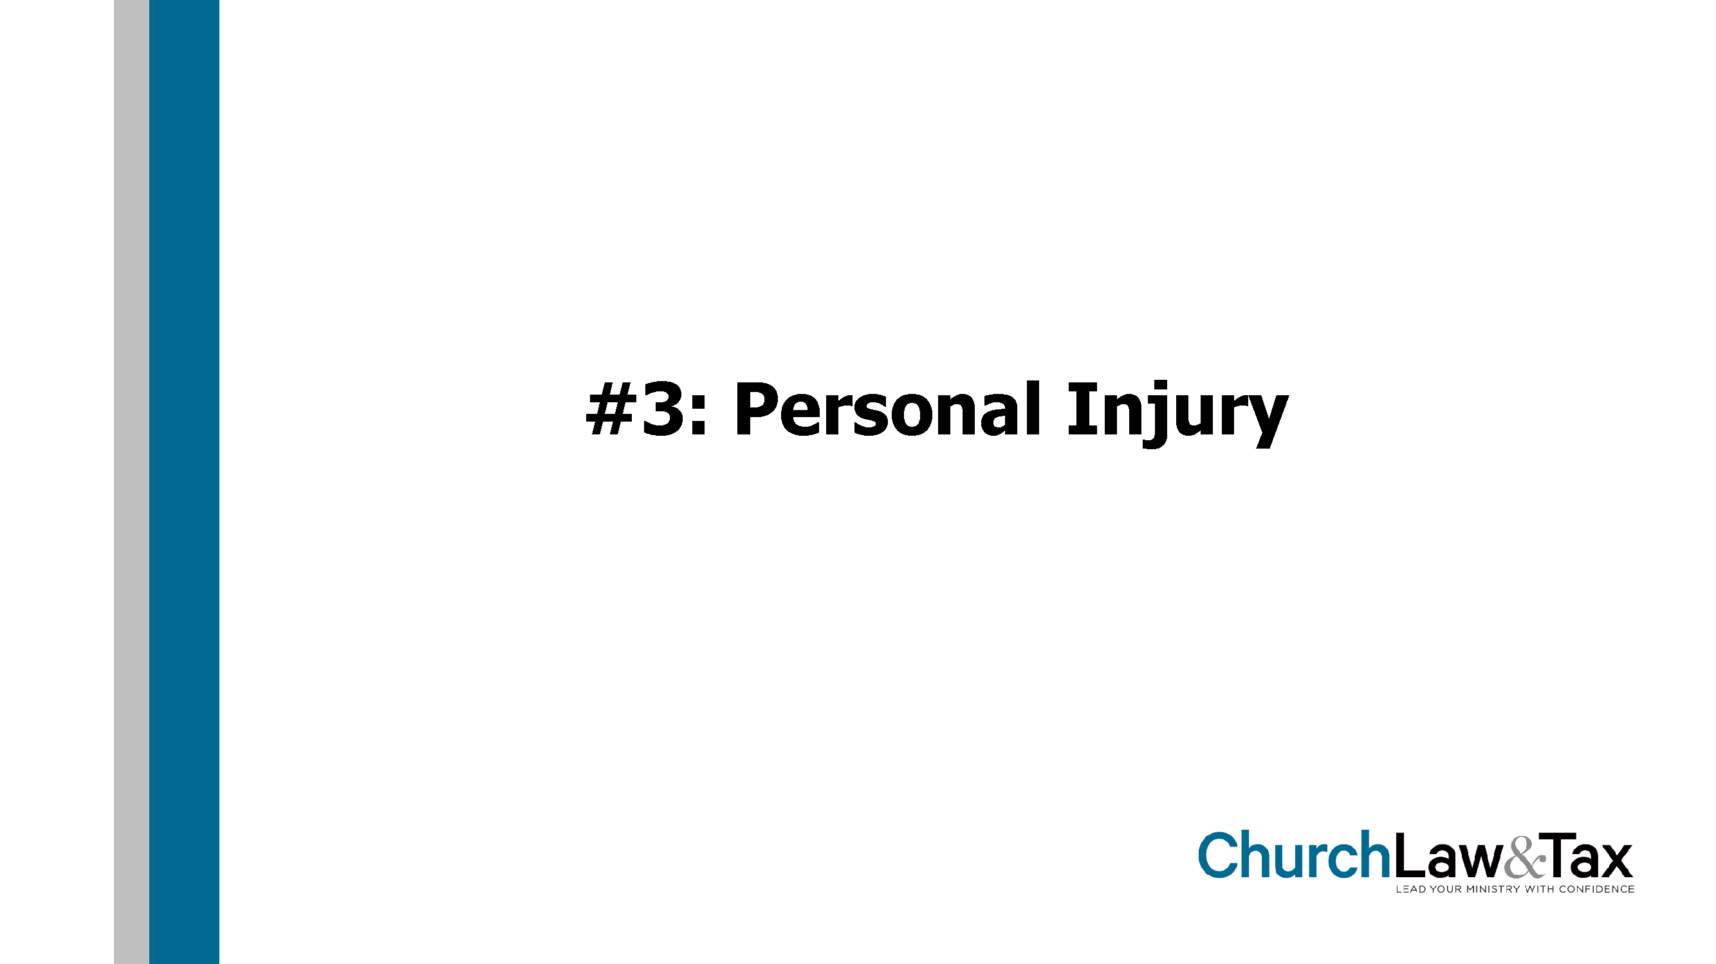

Slide 31
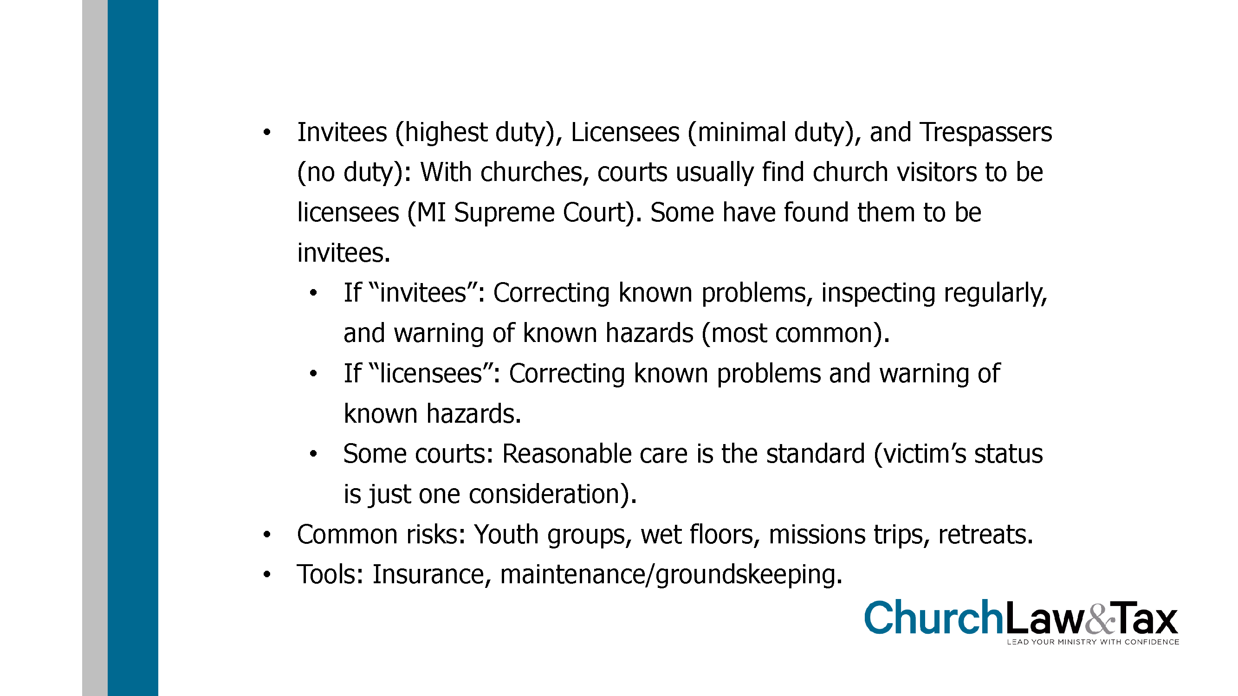

Slide 32
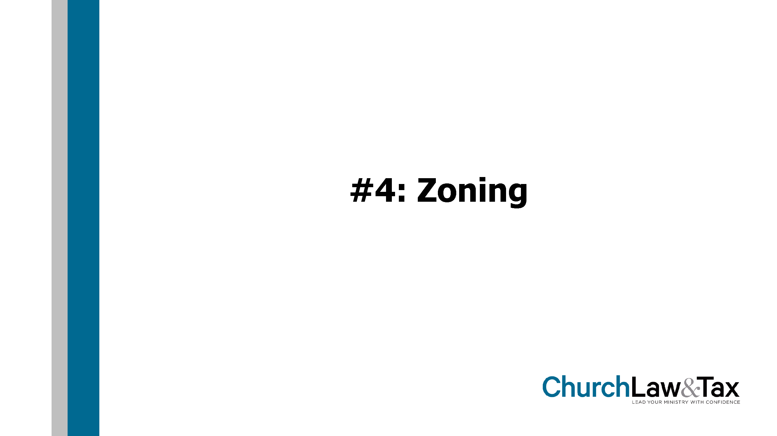

Slide 33
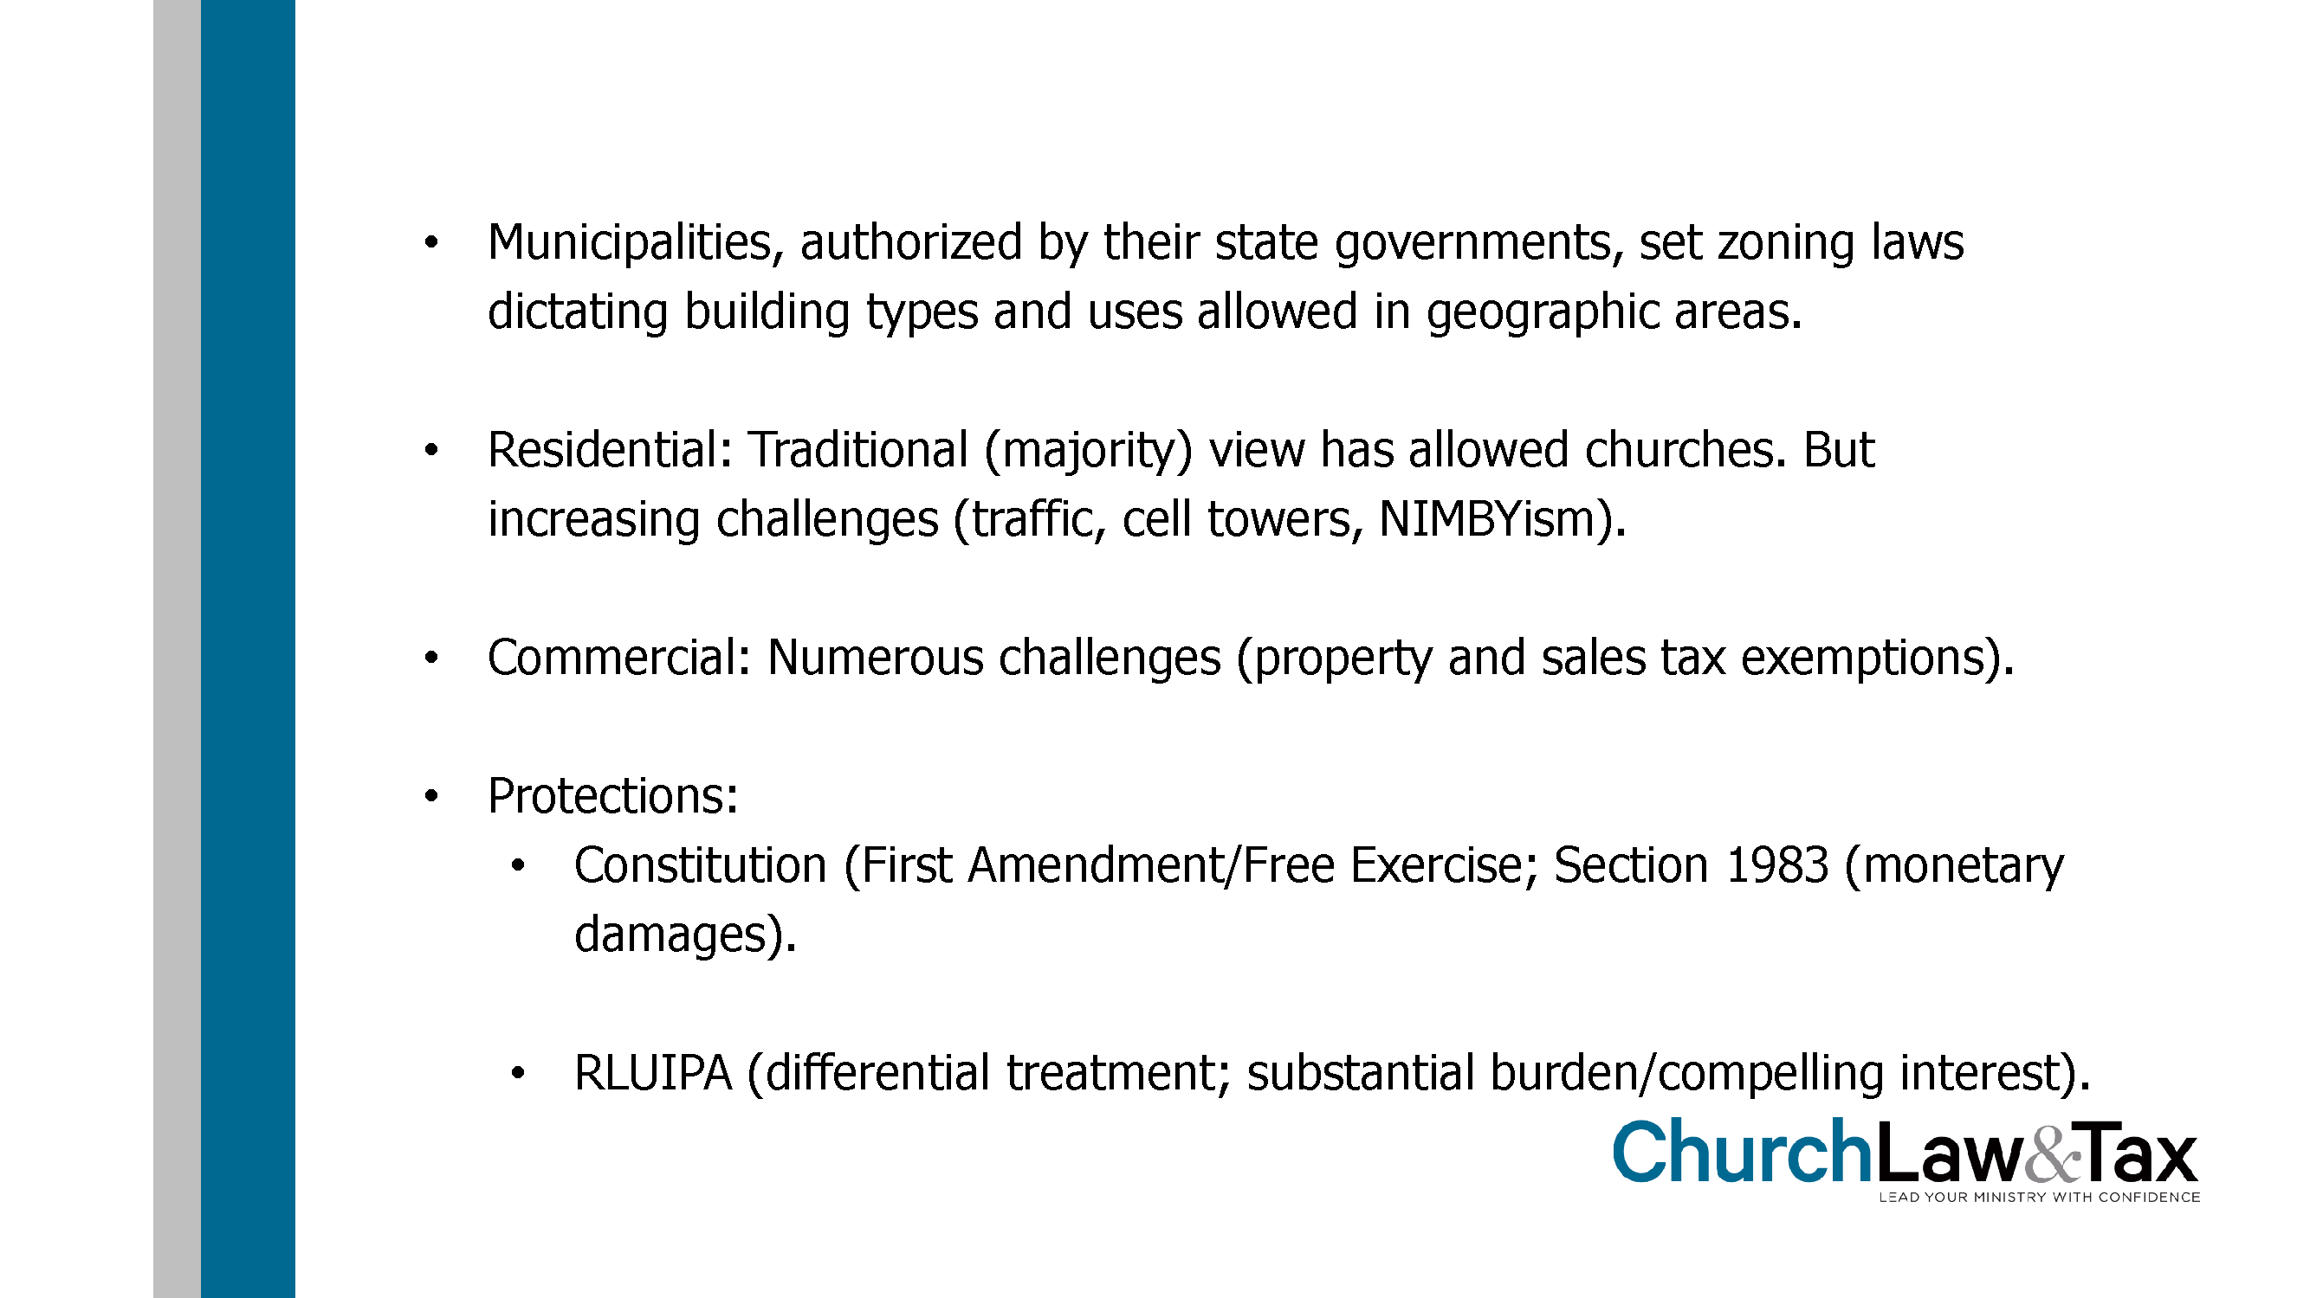

Slide 34
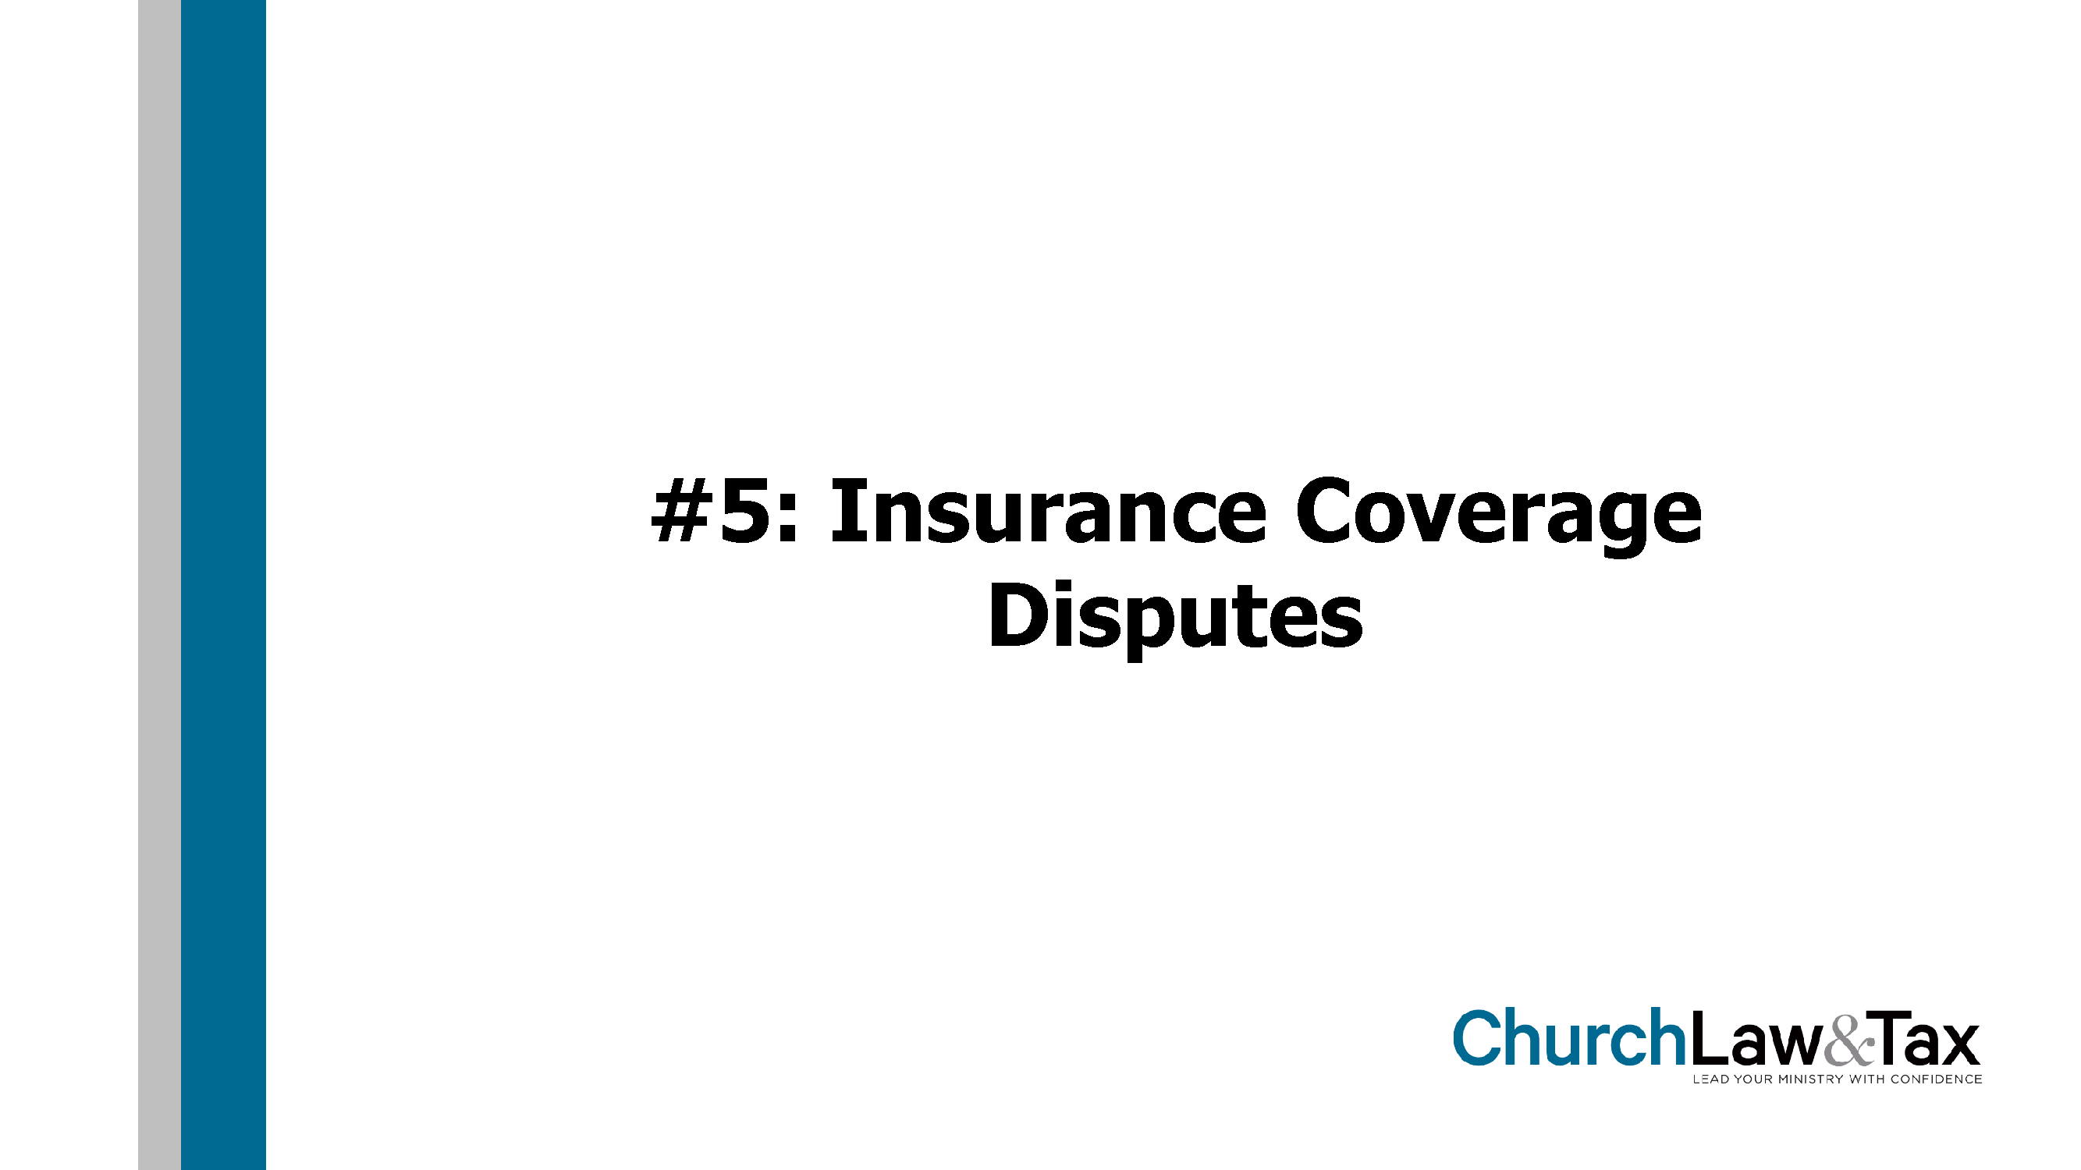

Slide 35
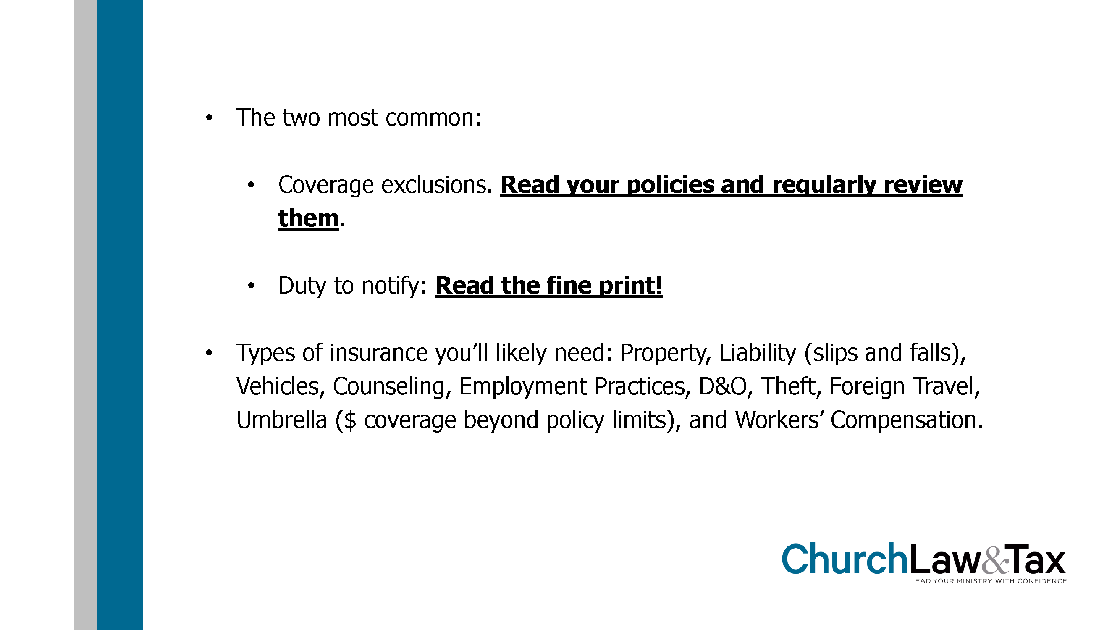

Slide 36
Abuse Prevention
TAB 3
Abuse Prevention Summary* (5 pages)
Mandated Reporters
General Abuse Prevention Guidelines

Slide 37
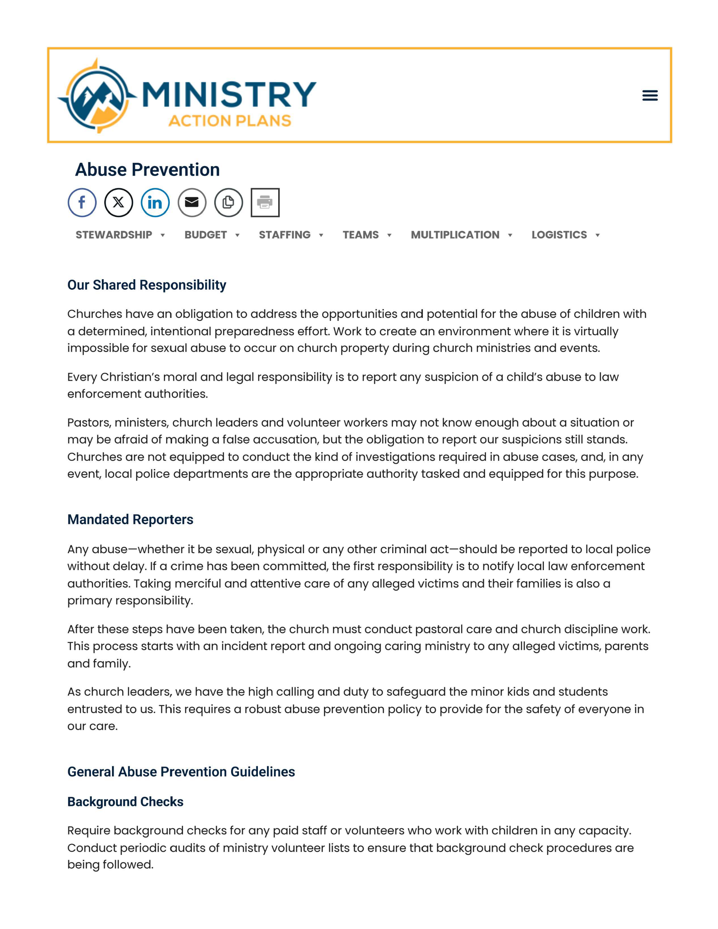

Slide 38
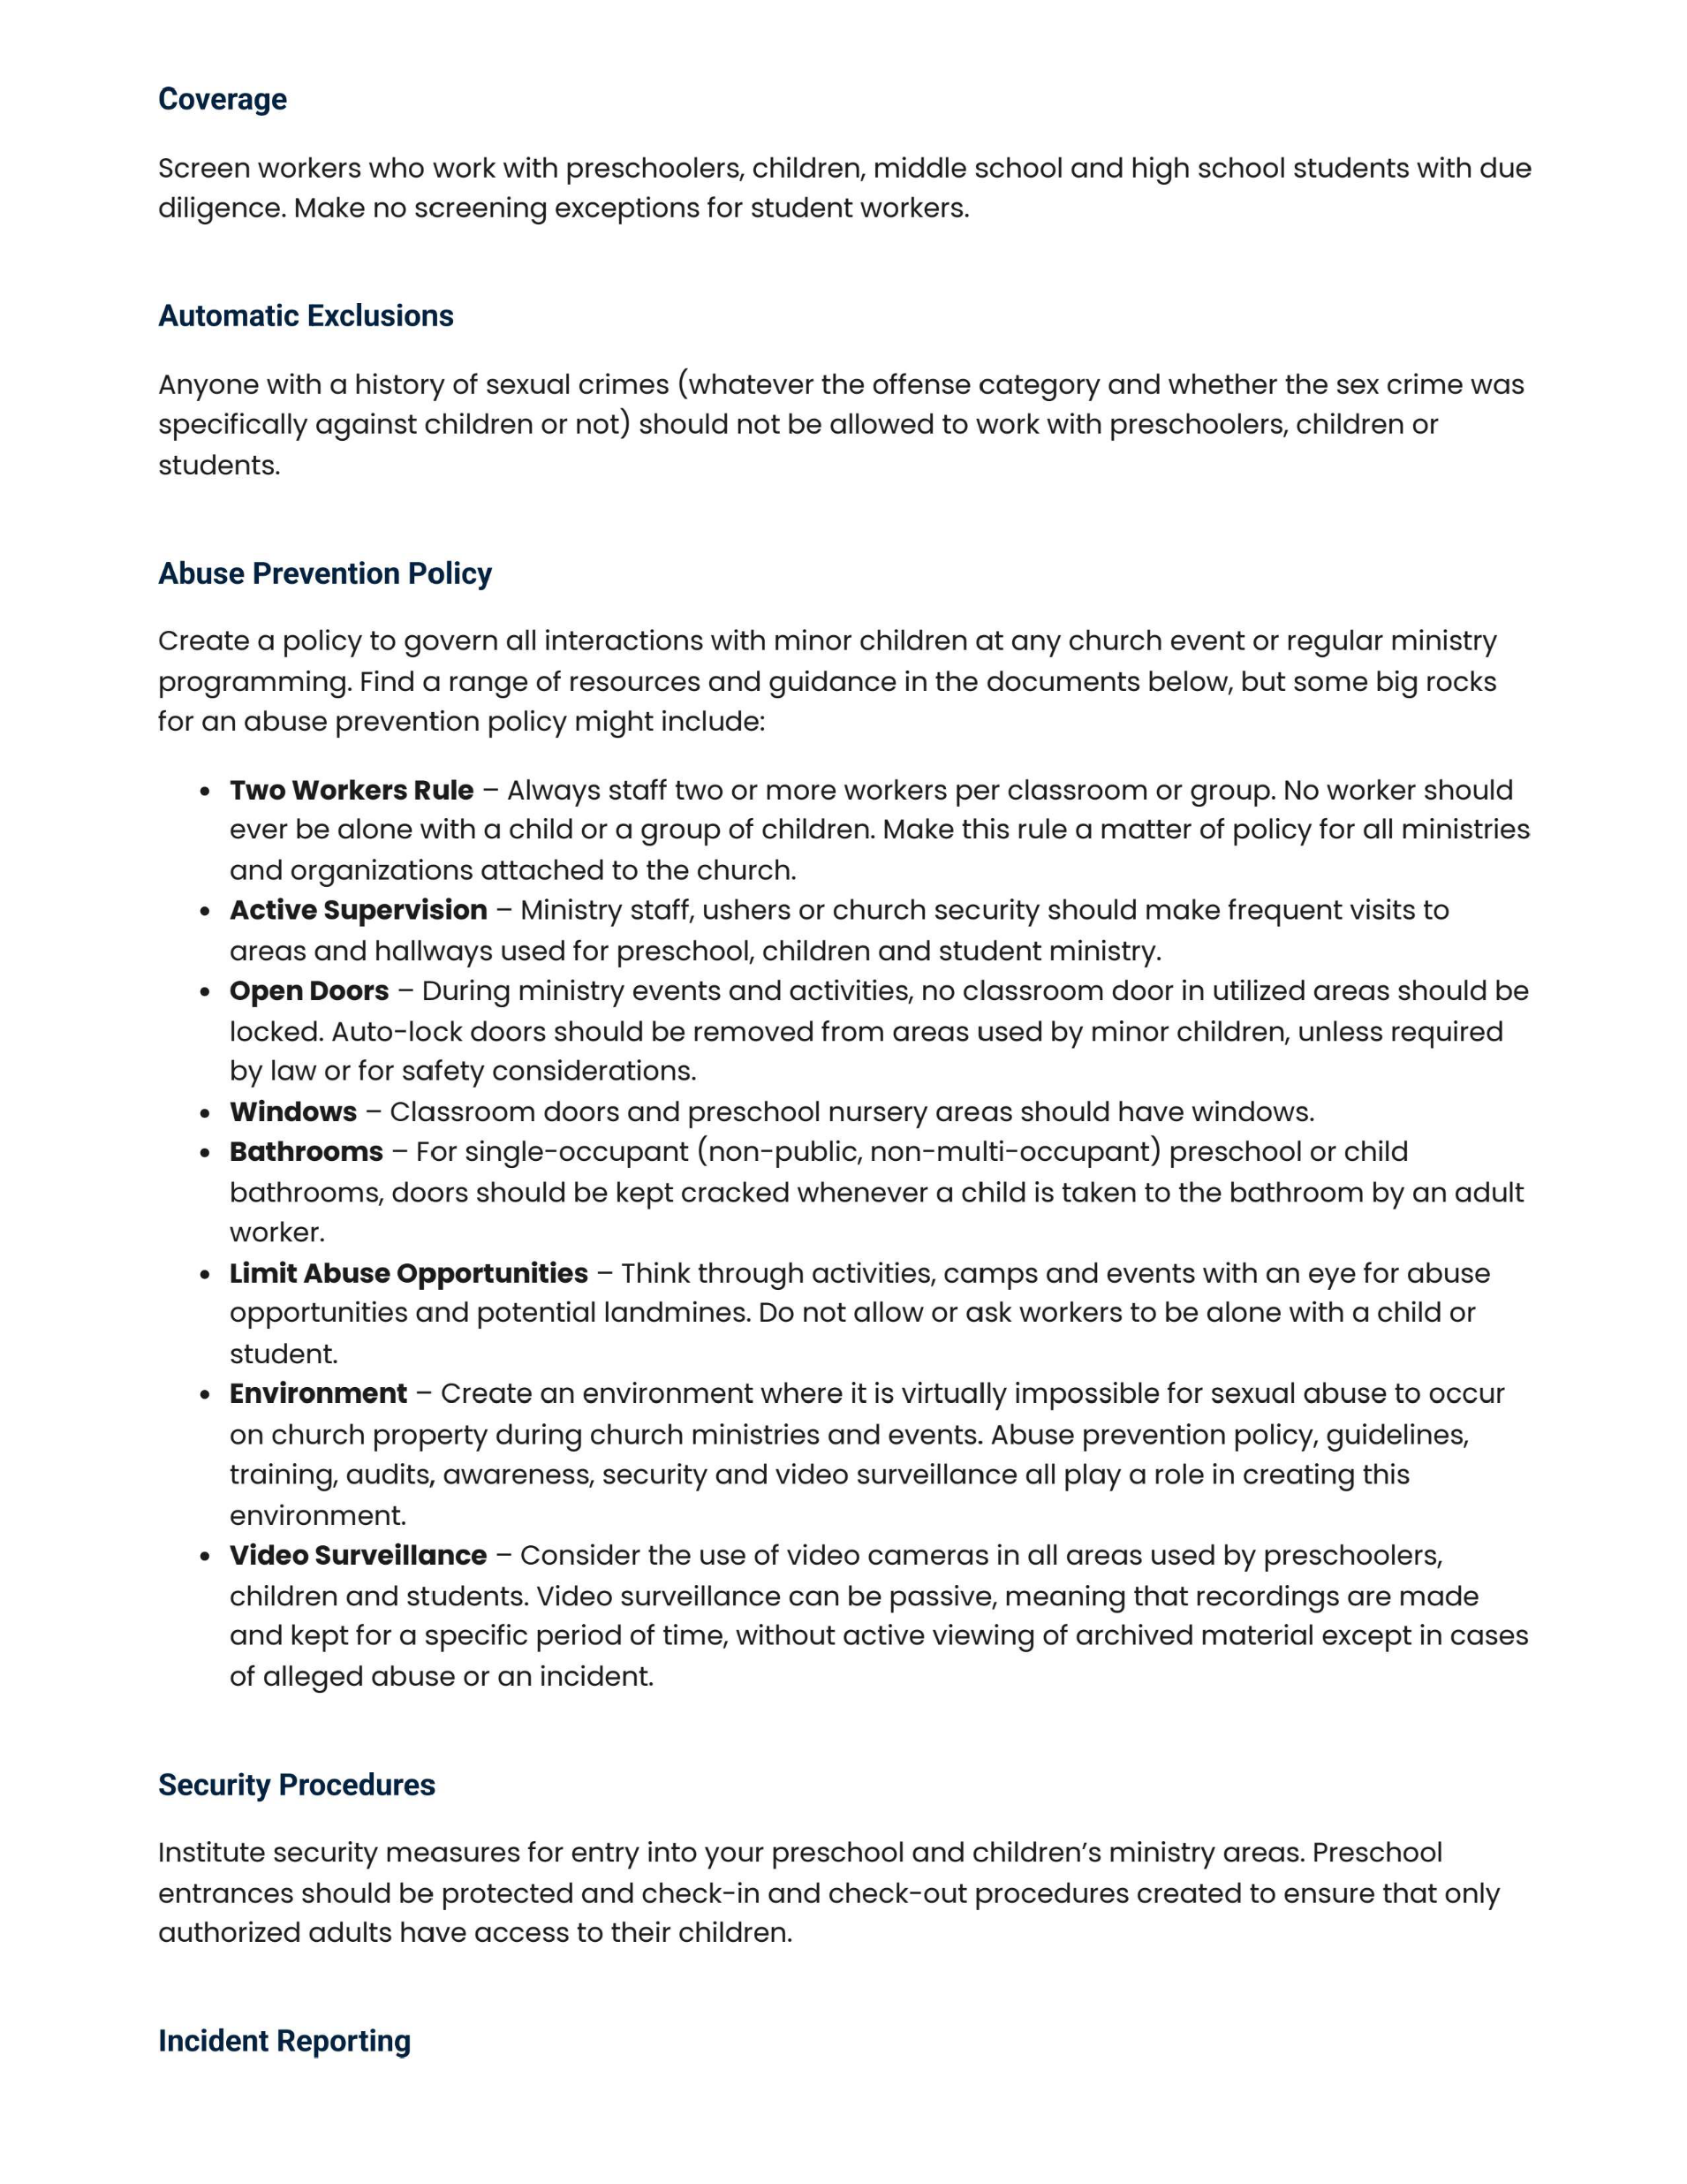

Slide 39
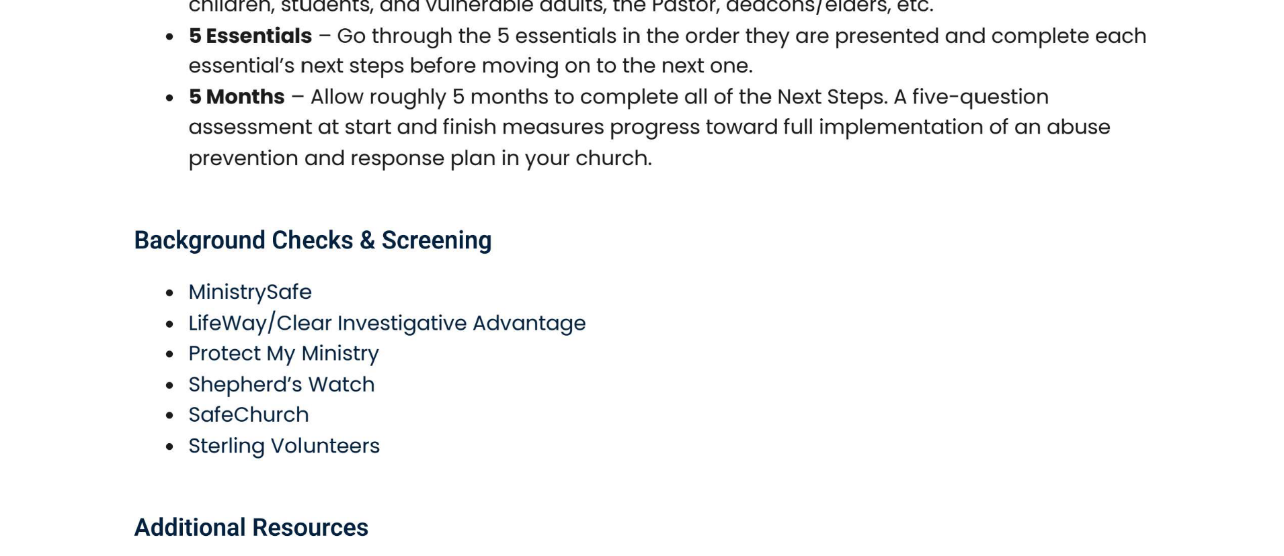
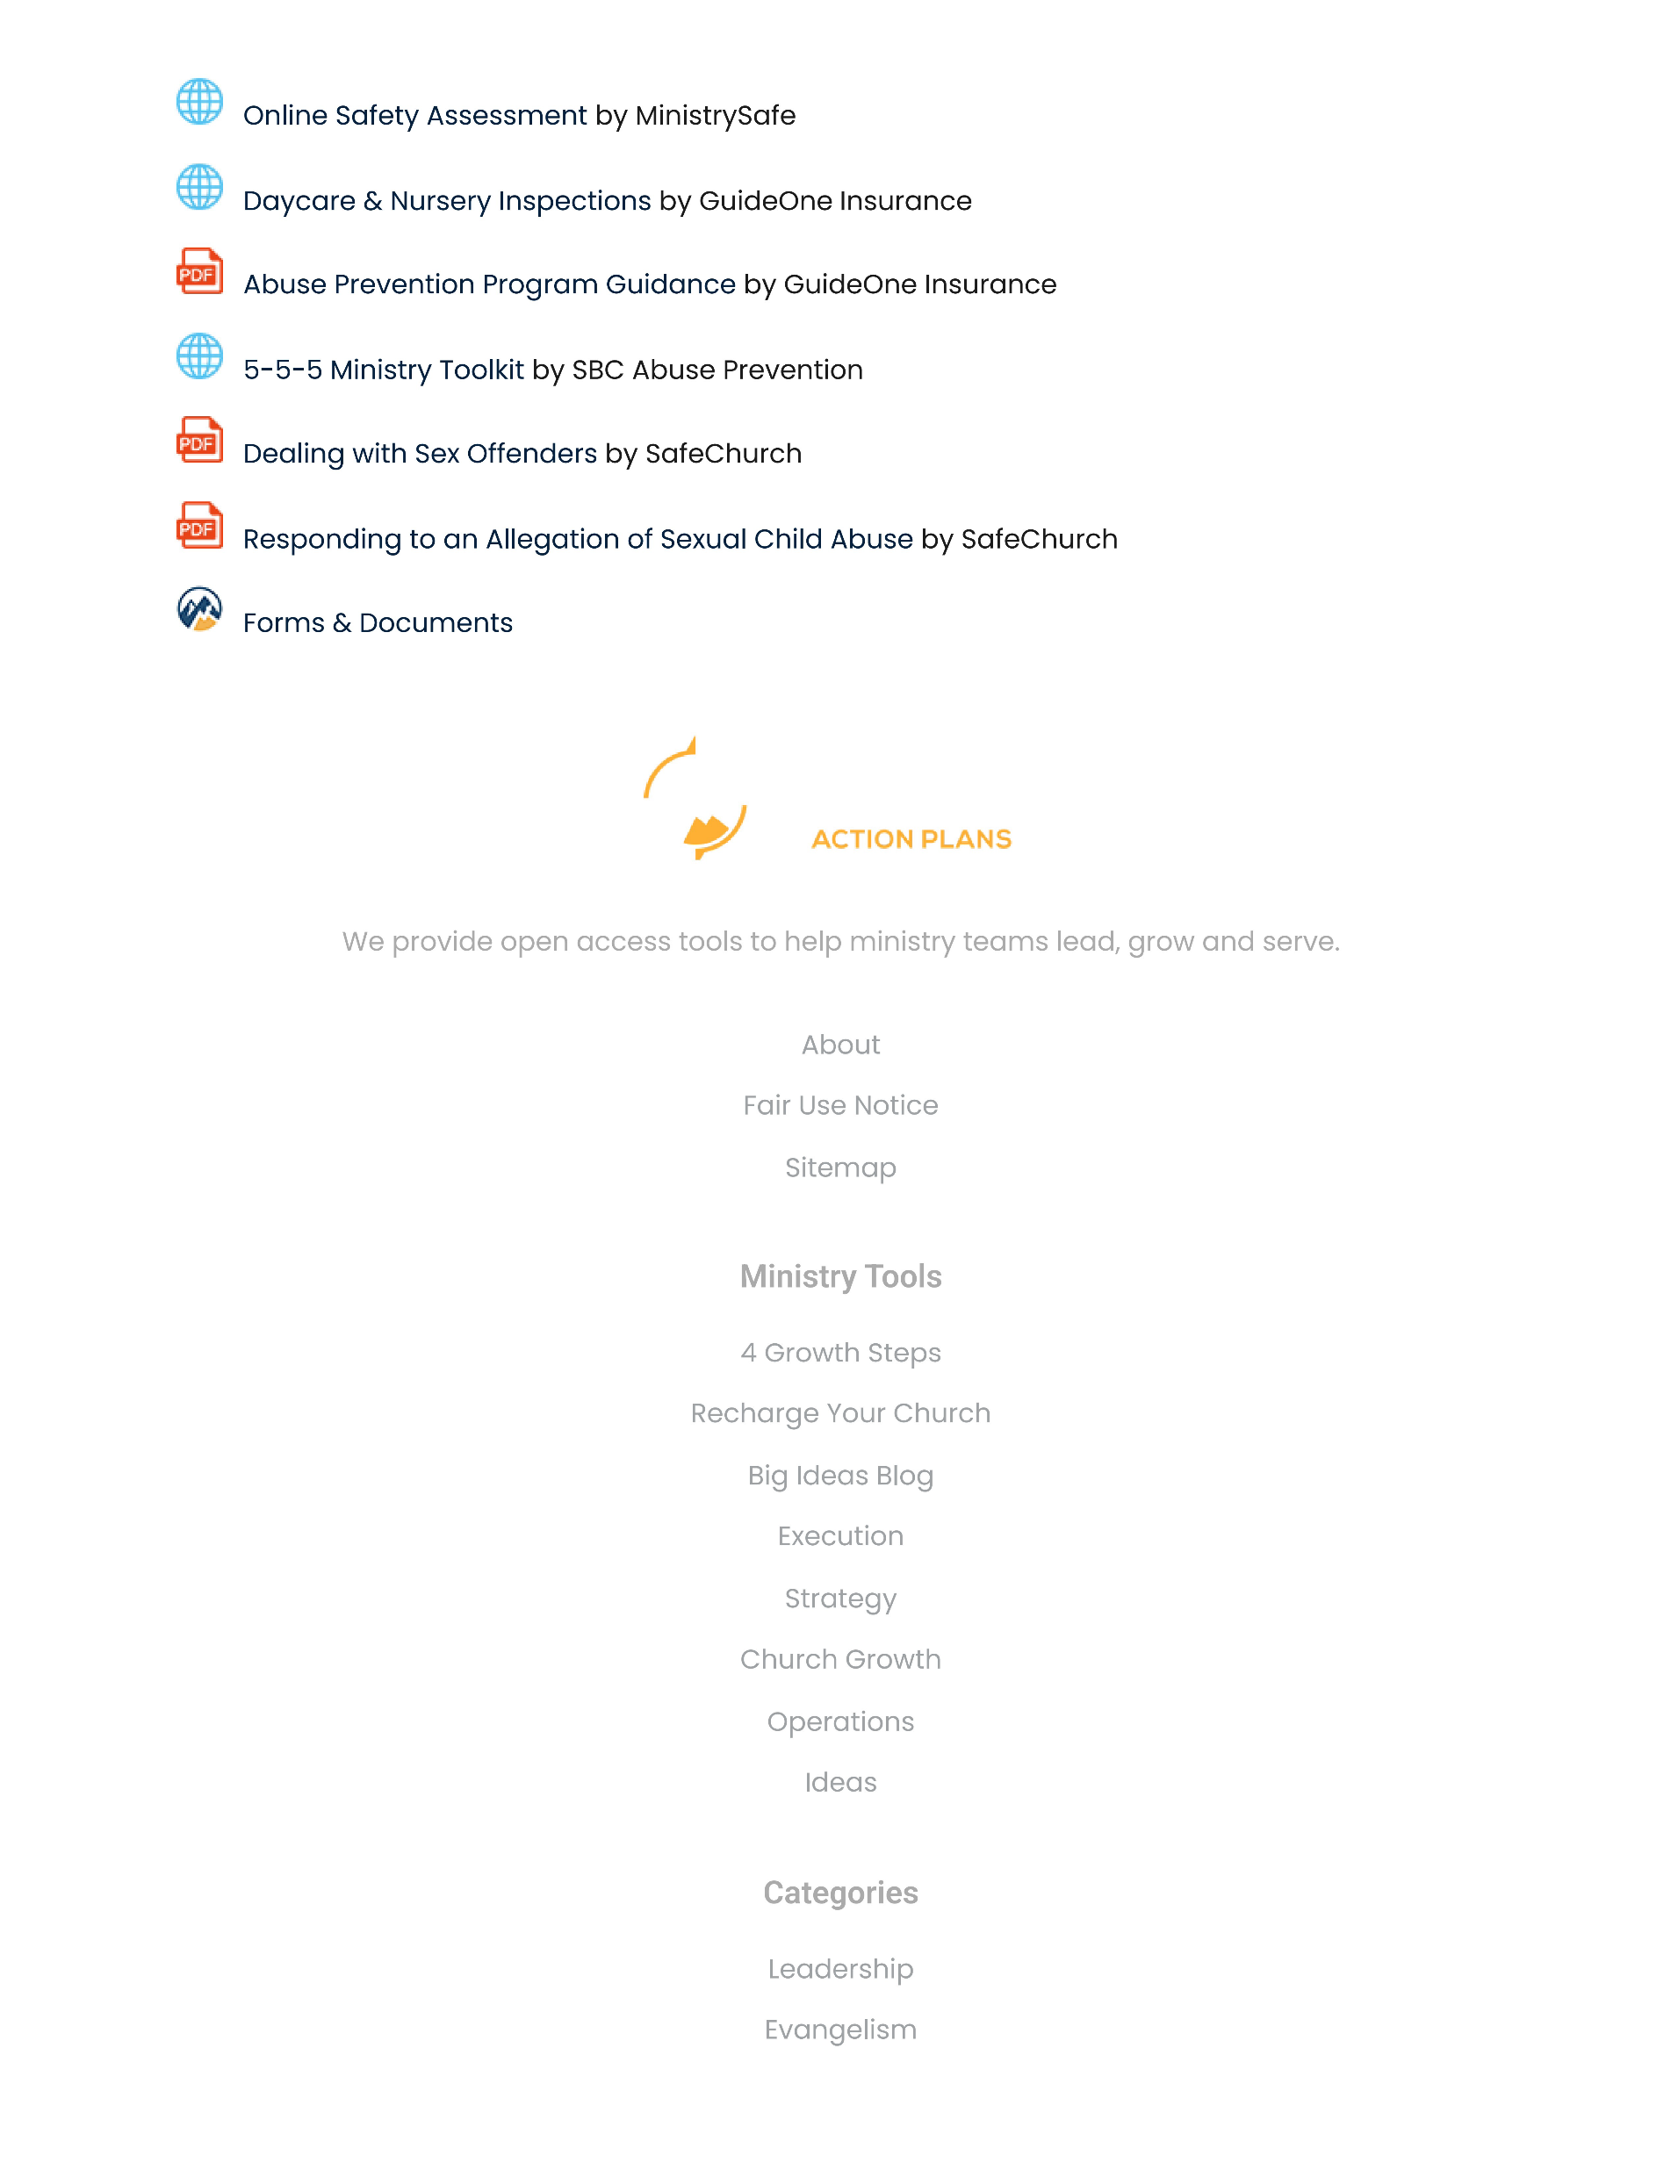

Slide 40
Abuse Prevention
TAB 3
Abuse Prevention Summary* (5 pages)
Mandated Reporters
General Abuse Prevention Guidelines
5-5-5 Method

Slide 41
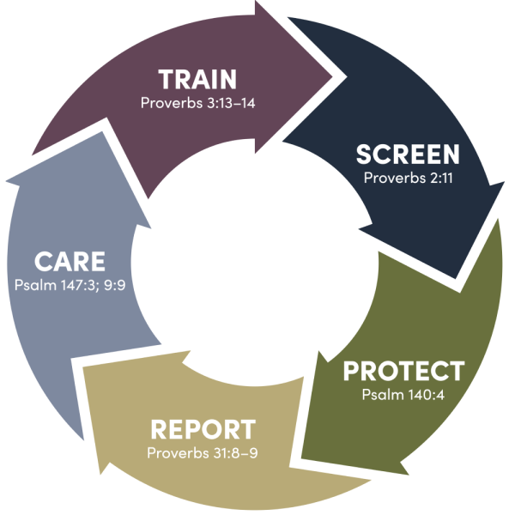
5-5-5 Method

Slide 42
Abuse Prevention
TAB 3
Abuse Prevention Summary* (5 pages)
Mandated Reporters
General Abuse Prevention Guidelines
5-5-5 Method
"Mandated Reporters of Child Abuse and Neglect" by Louisiana DCFS* (2 pages)

Slide 43
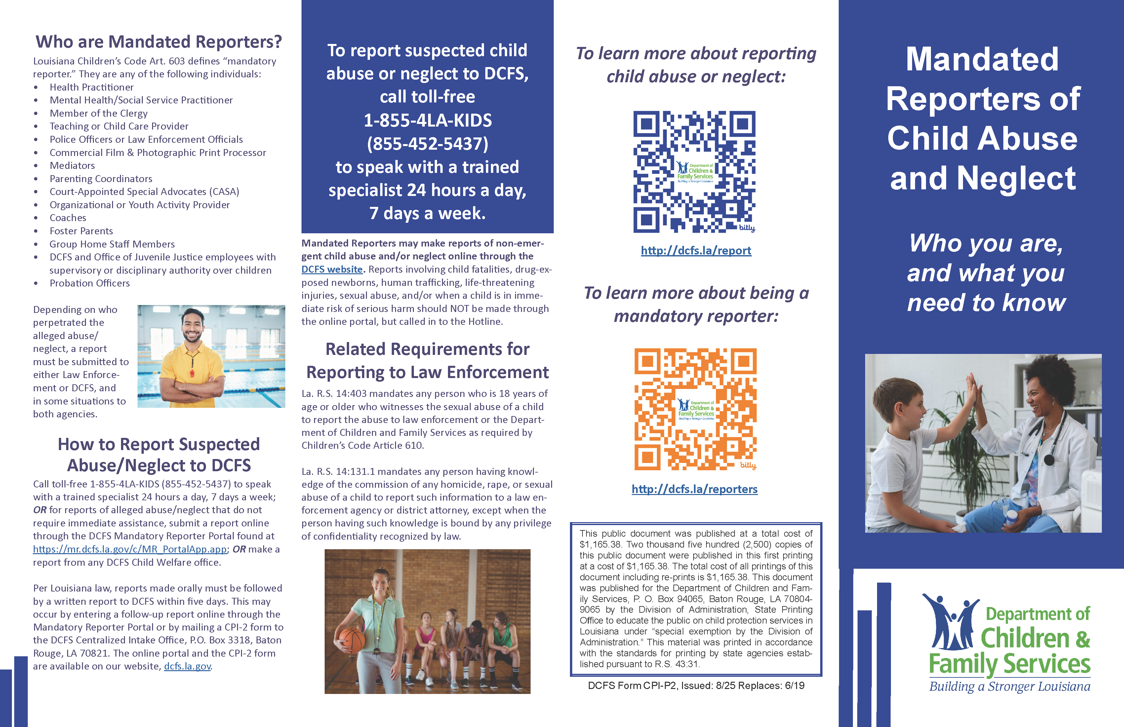

Slide 44
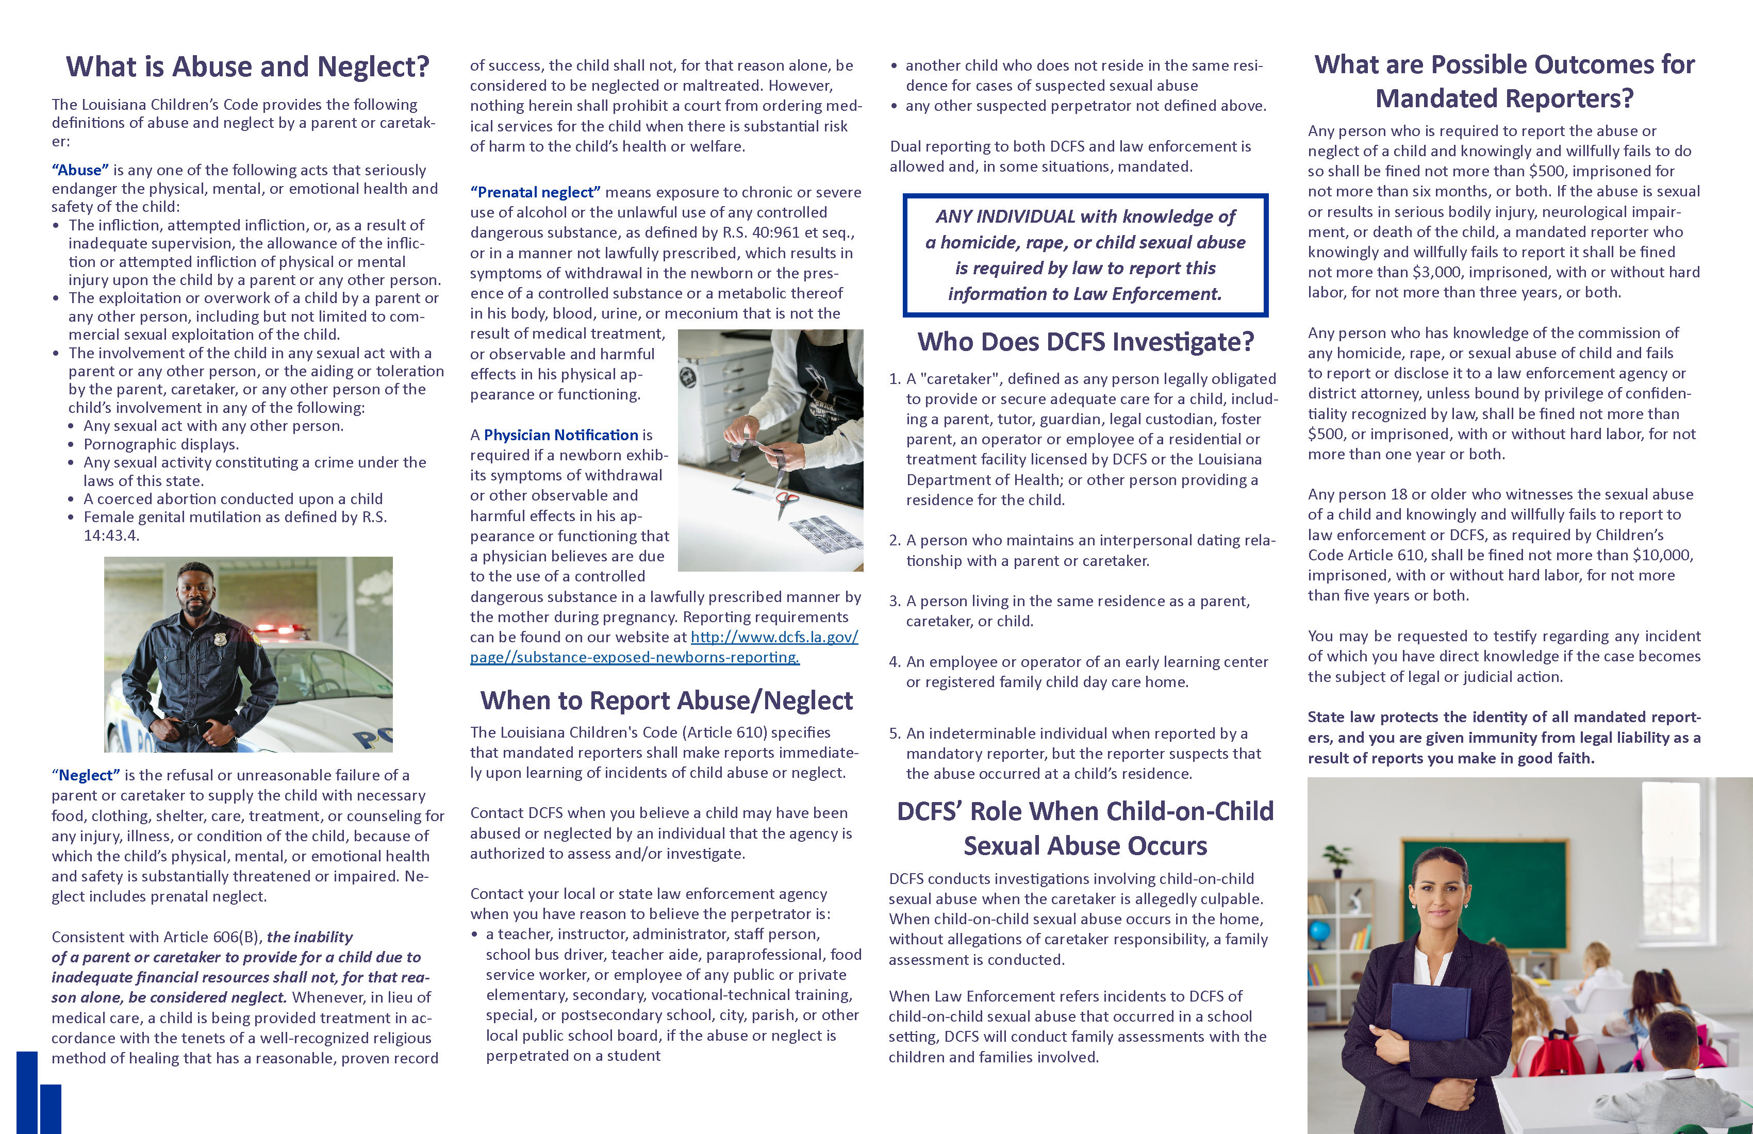

Slide 45
Abuse Prevention
TAB 3
Abuse Prevention Summary* (5 pages)
Mandated Reporters
General Abuse Prevention Guidelines
5-5-5 Method
"Mandated Reporters of Child Abuse and Neglect" by Louisiana DCFS* (2 pages) – Consult mandated reporting laws in your state for clear guidance on legal obligations for churches and religious workers.
Accident Report* (1 page)

Slide 46
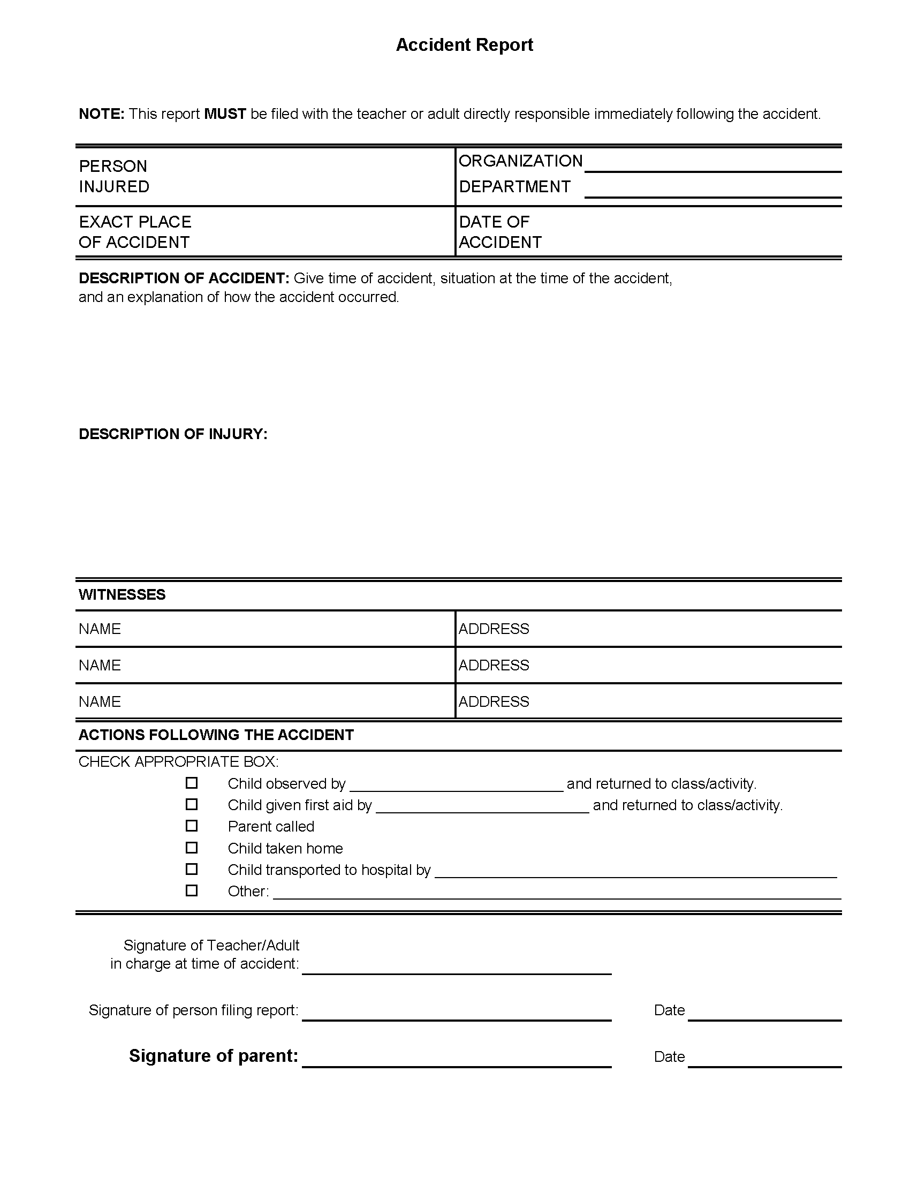

Slide 48
Abuse Prevention
TAB 3
Abuse Prevention Summary* (5 pages)
Mandated Reporters
General Abuse Prevention Guidelines
5-5-5 Method
"Mandated Reporters of Child Abuse and Neglect" by Louisiana DCFS* (2 pages)
Accident Report* (1 page)
Summer Camps/Trips Safety E-mail* (2 pages)
First West Child Protection Policy/Reporting Process* (5 pages)
Houston's First Baptist Church Protection Policy* (14 pages)
Sex Offender Policy* (3 pages)

Slide 49
Liability & Personal Injury
TAB 4
Lawsuits
Interrogatories
Internal Documents and Communication
Intimidation Tactics
Insurance Company's Role
Settlements
Waiver of Liability & Medical Release - Minor* (2 pages)

Slide 50
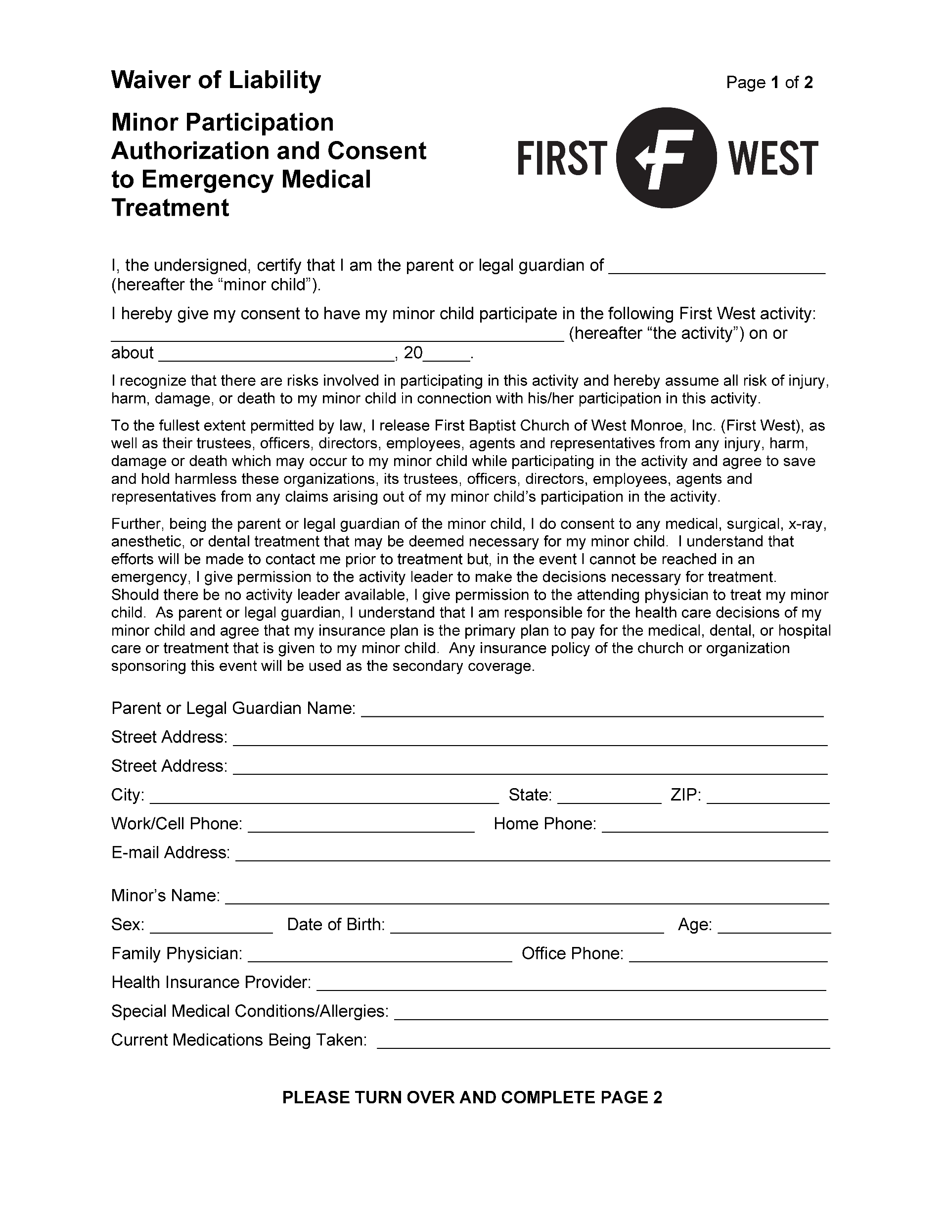

Slide 51
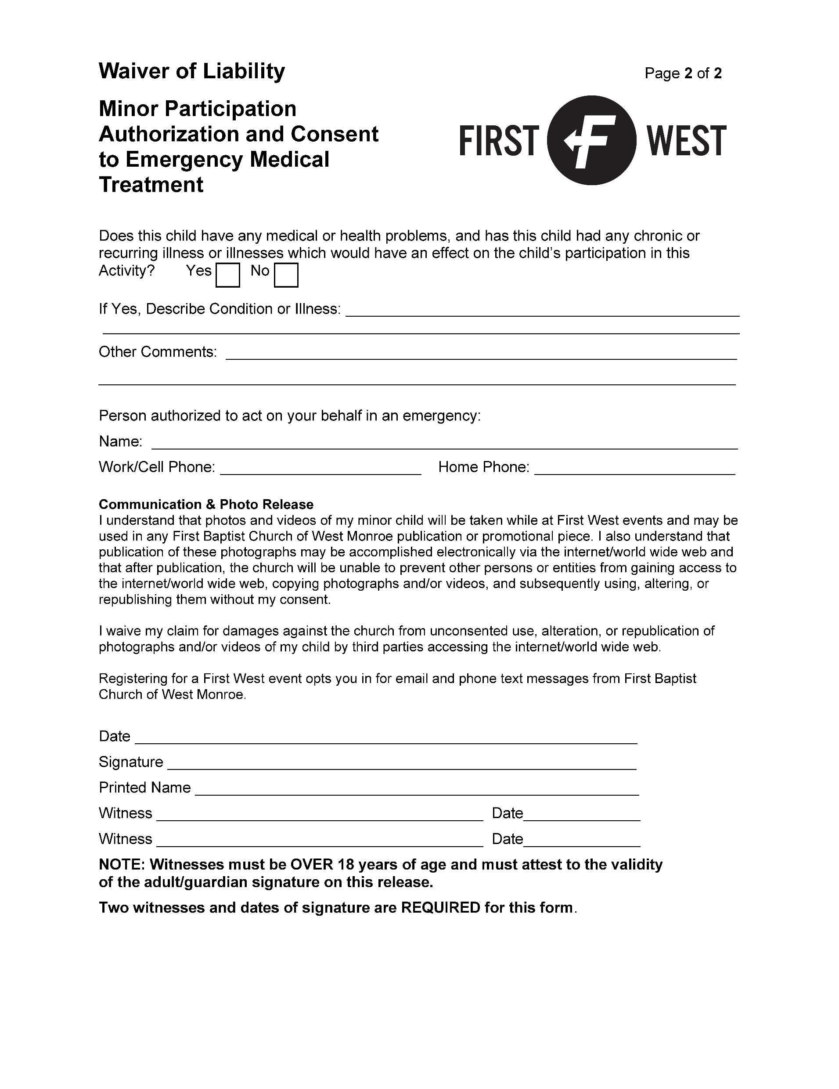

Slide 52
Liability & Personal Injury
TAB 4
Lawsuits
Interrogatories
Internal Documents and Communication
Intimidation Tactics
Insurance Company's Role
Settlements
Waiver of Liability & Medical Release - Minor* (2 pages)
Waiver of Liability & Medical Release - Adult* (2 pages)
Incident Report* (1 page)
"Church Self-Inspection Form“ by Adventist Risk Management, Inc.* (11 pages)
3-8-23 Claim #000-01-258011 E-mail* (3 pages)

Slide 53
Insurance Coverage Disputes
TAB 5
2023 Insurance Issues Report* (3 pages)
Louisiana Insurance Climate
Non-Renewals
Wind/Hail Exclusions and Disputes
Negotiation
Policyholders Release* (1 page)

Slide 54
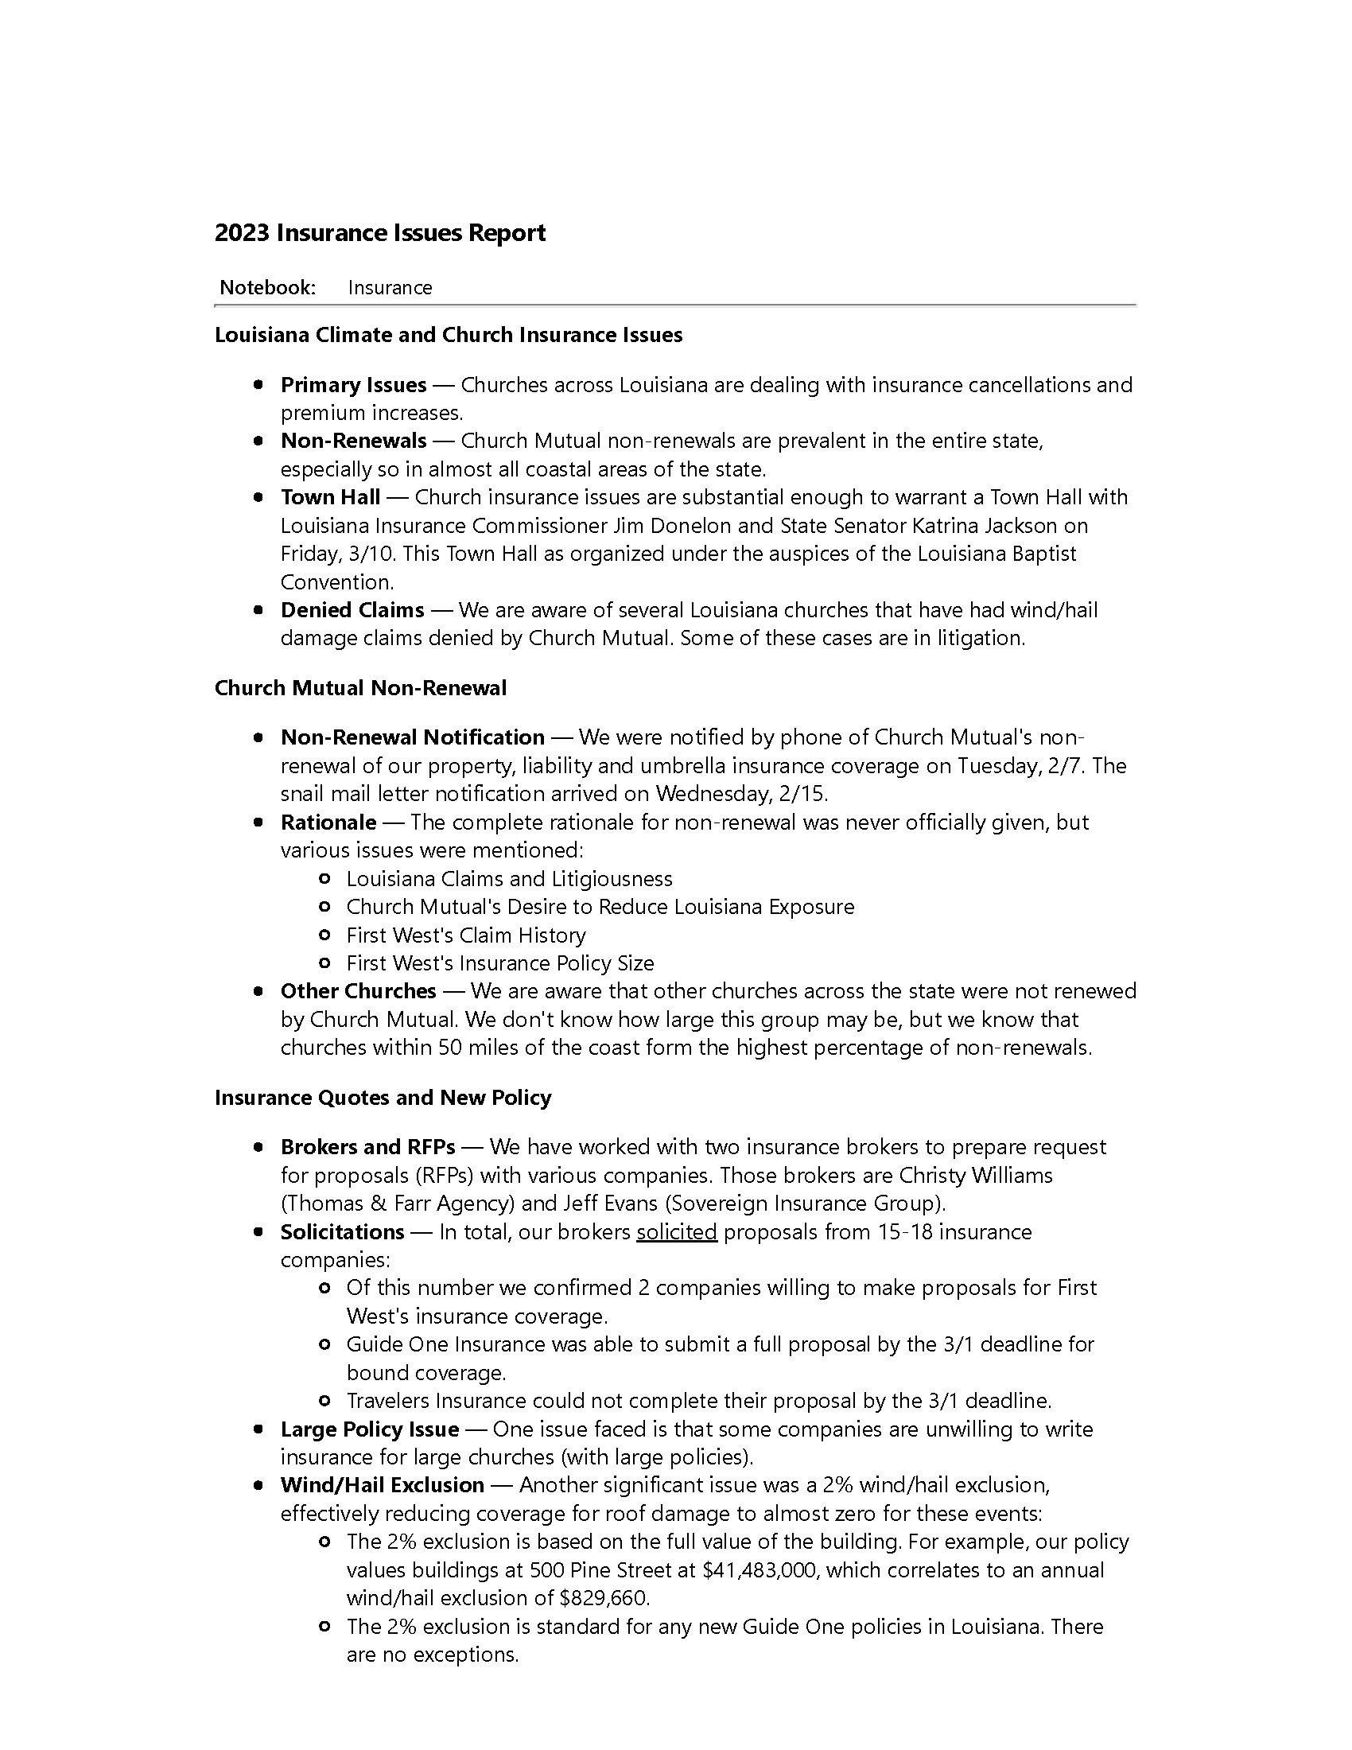

Slide 56
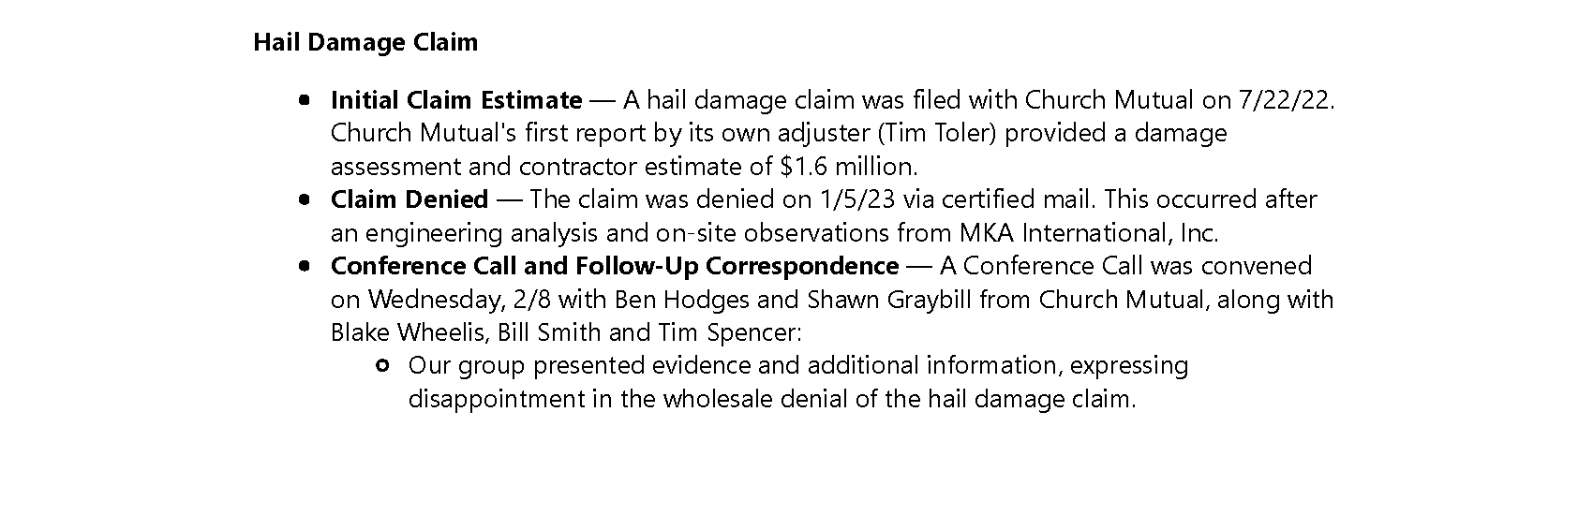
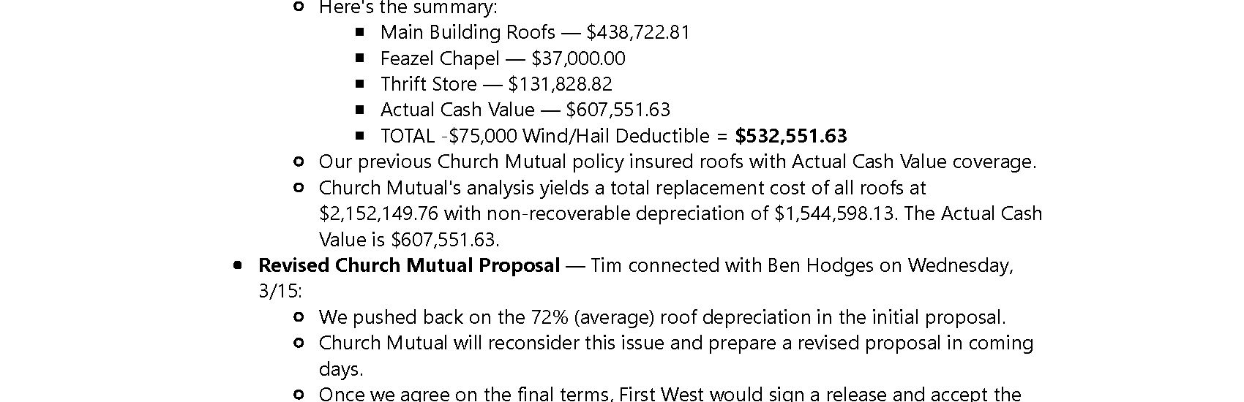

Slide 57
Facilities, Weddings & Funerals
TAB 6
Policy Issues Summary* (4 pages)
Abuse Prevention Policy
Minor Participation Policy
Social Media Policy
Staff Team Policies
ADA Compliance
Facility Use Policy* (4 pages)
Weddings
Definition of Marriage* (3 pages)

Slide 58
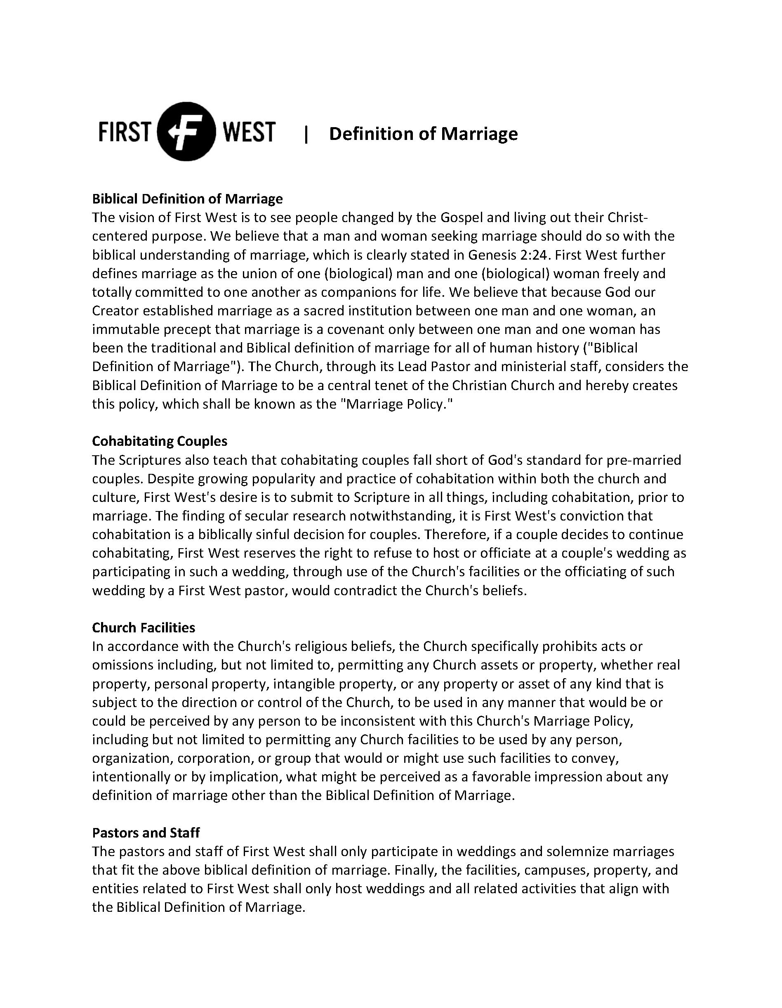

Slide 60
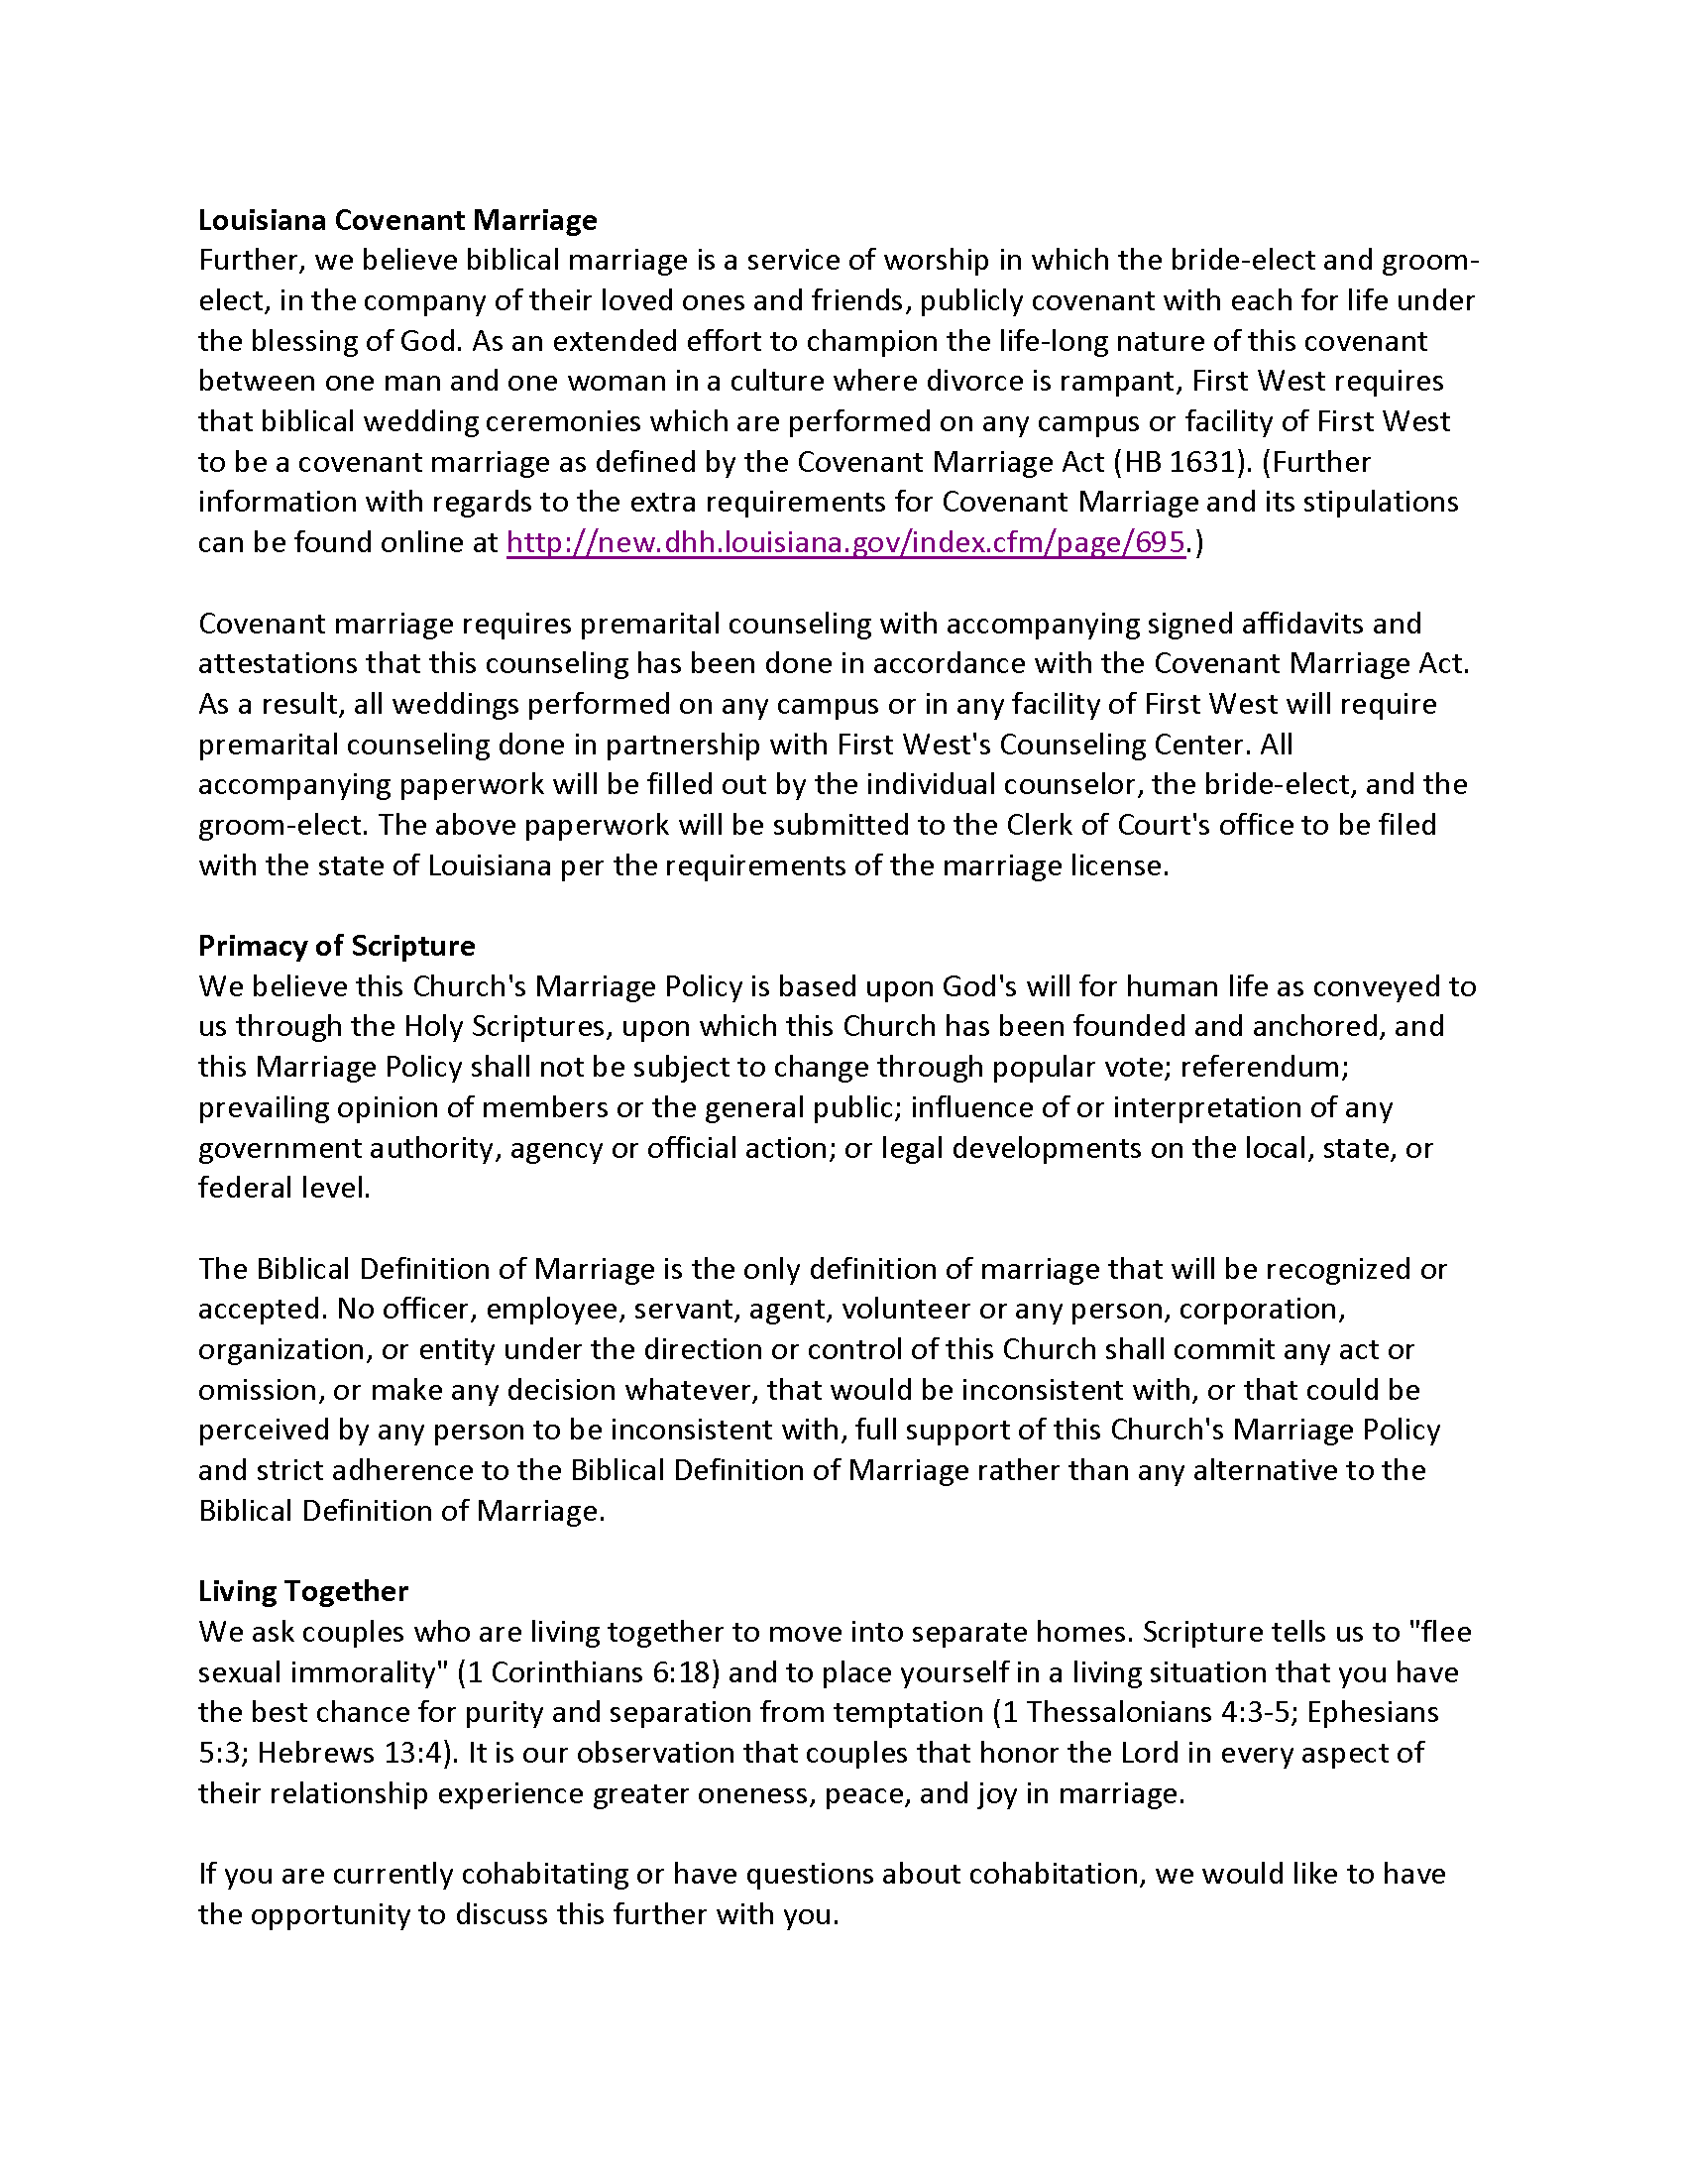

Slide 61
Facilities, Weddings & Funerals
TAB 6
Policy Issues Summary* (4 pages)
Abuse Prevention Policy
Minor Participation Policy
Social Media Policy
Staff Team Policies
ADA Compliance
Facility Use Policy* (4 pages)
Weddings
Definition of Marriage* (3 pages)
Covenant Marriage Summary* (2 pages)
Covenant Marriage Position Paper* (6 pages)
Wedding Handbook* (33 pages)

Slide 62
Facilities, Weddings & Funerals
TAB 6
Funerals
Potential Area of Future Litigation
Funeral Policy Development
Facility Use Policy
How Inclusive Will the Church Be?
Is there a Membership Requirement?
What Content Is Permissible?
Who Officiates?
DRAFT Transgender Guidelines* (1 page)
"Churches Are Not Places of Public Accommodation“ by Harvard Law School Journal on Legislation* (4 pages)
Service & Comfort Animals Policy* (4 pages)

Slide 63
Constitution/Bylaws & Admin.
TAB 7
Church Bylaws Summary* (3 pages)
Constitution & Bylaw Legal Protections
Marriage & Sexuality
Biblical Authority
Membership Definition
Member Discipline Procedures
Procedure for Rescinding Membership
"Suggested Language for Church Bylaws“ by Alliance Defending Freedom* (1 page)
"Five Things All Churches Should Have in Their Bylaws“ by Alliance Defending Freedom* (5 pages)

Slide 64
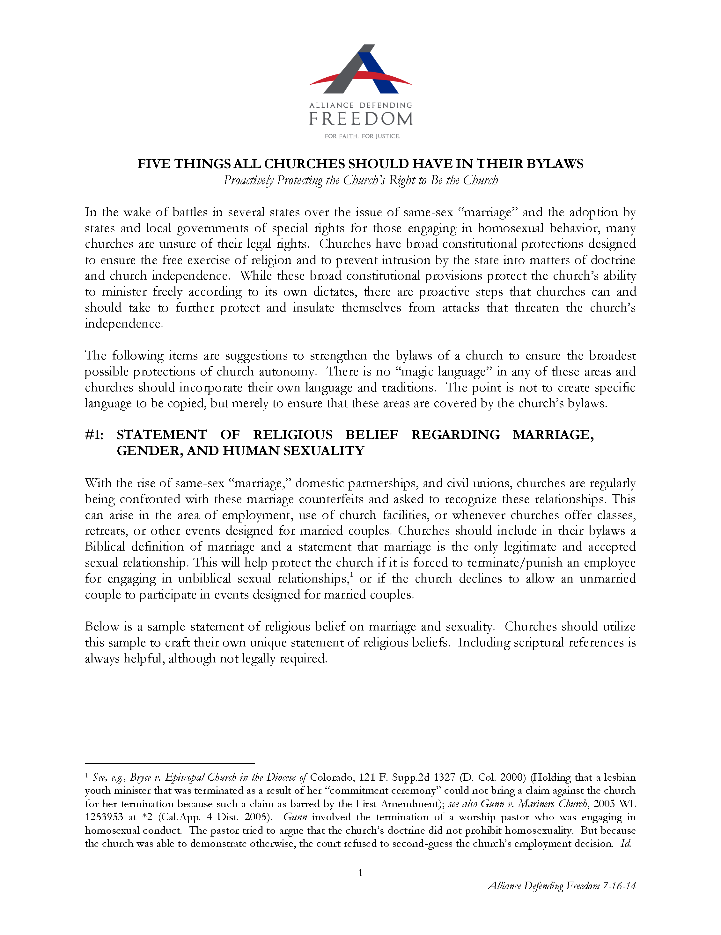

Slide 65
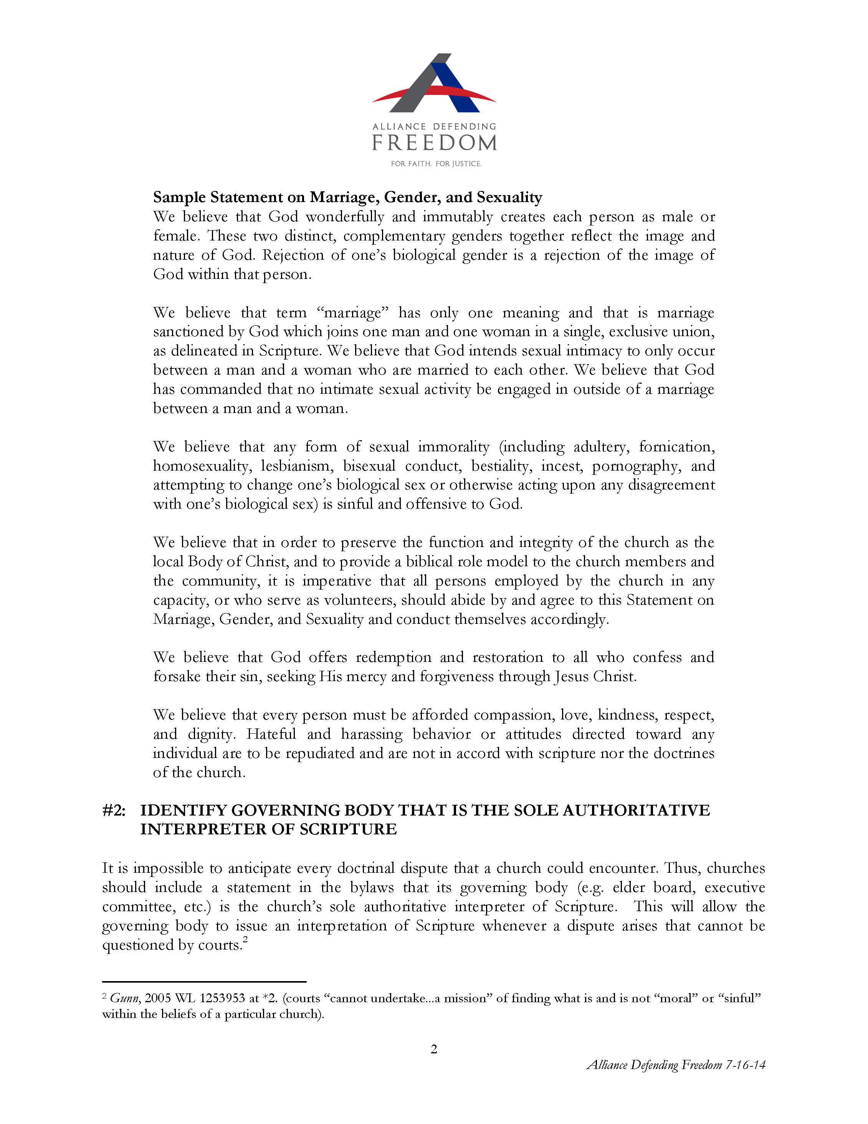

Slide 66
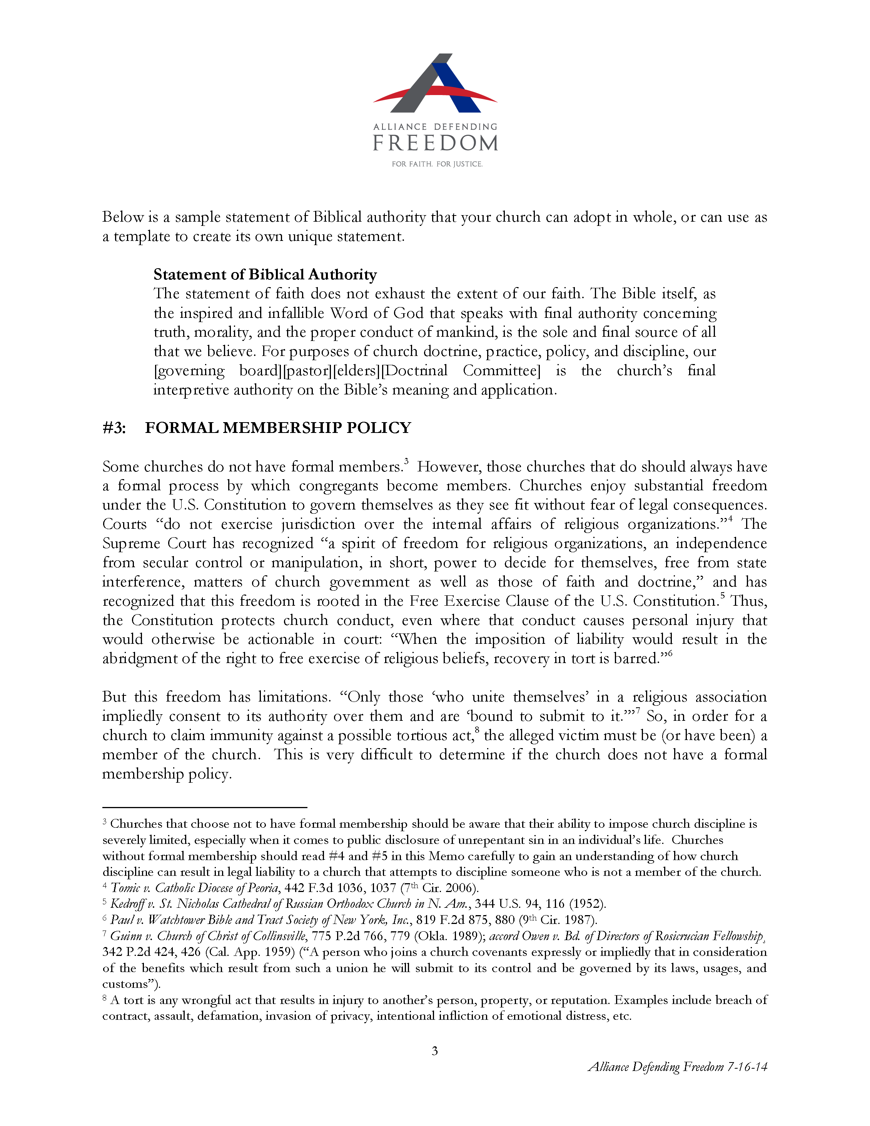

Slide 67
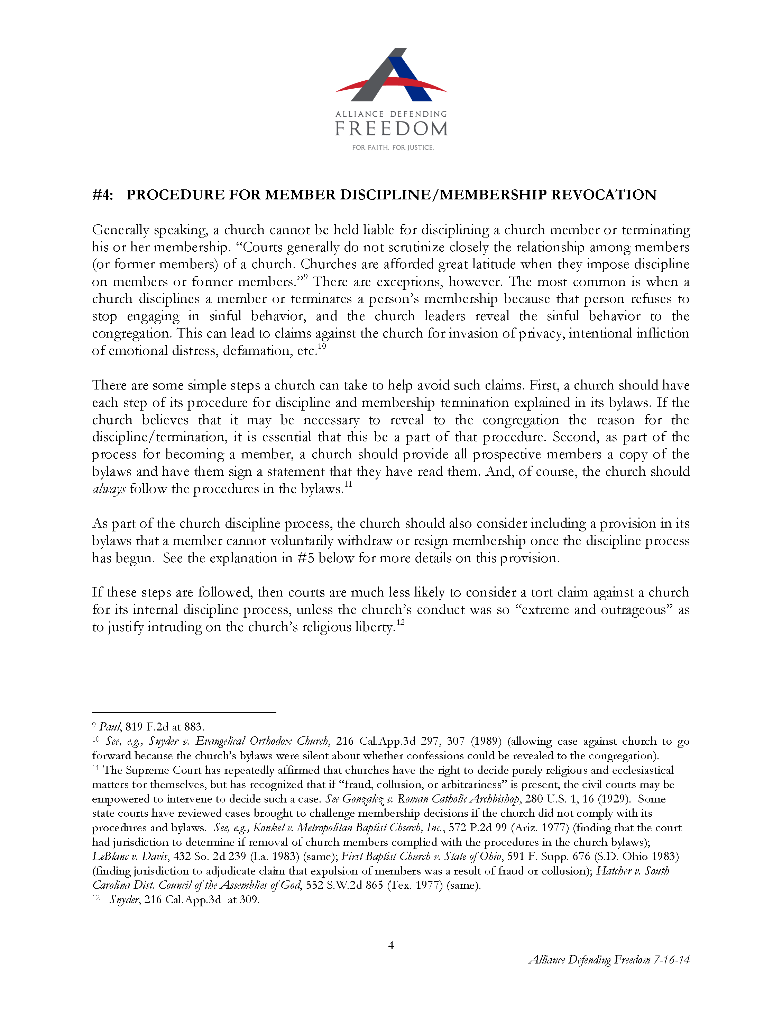

Slide 68
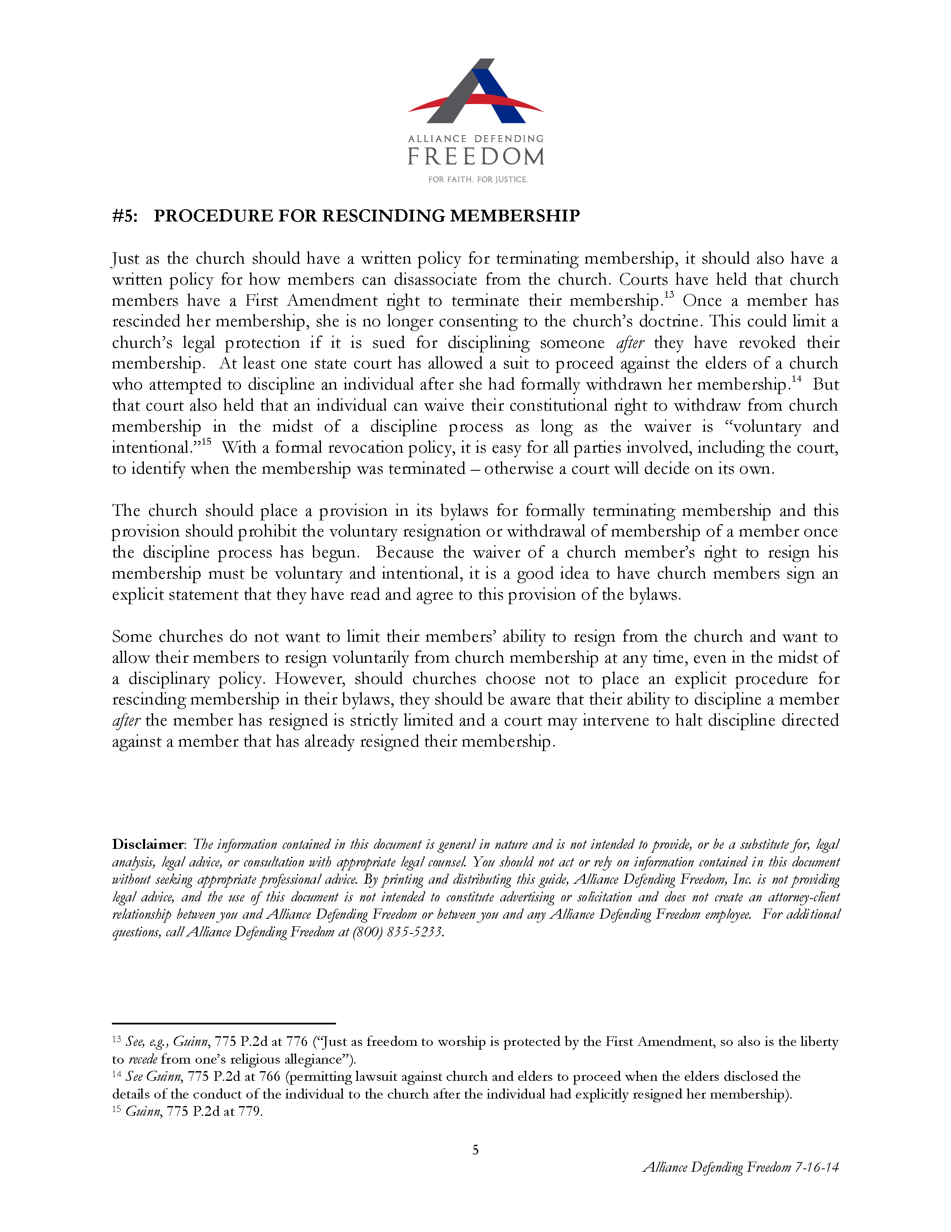

Slide 69
Constitution/Bylaws & Admin.
TAB 7
First West 2025 Constitutional Amendment* (4 pages)
Statement of Faith and Doctrine
Final Interpretive Authority

Slide 70
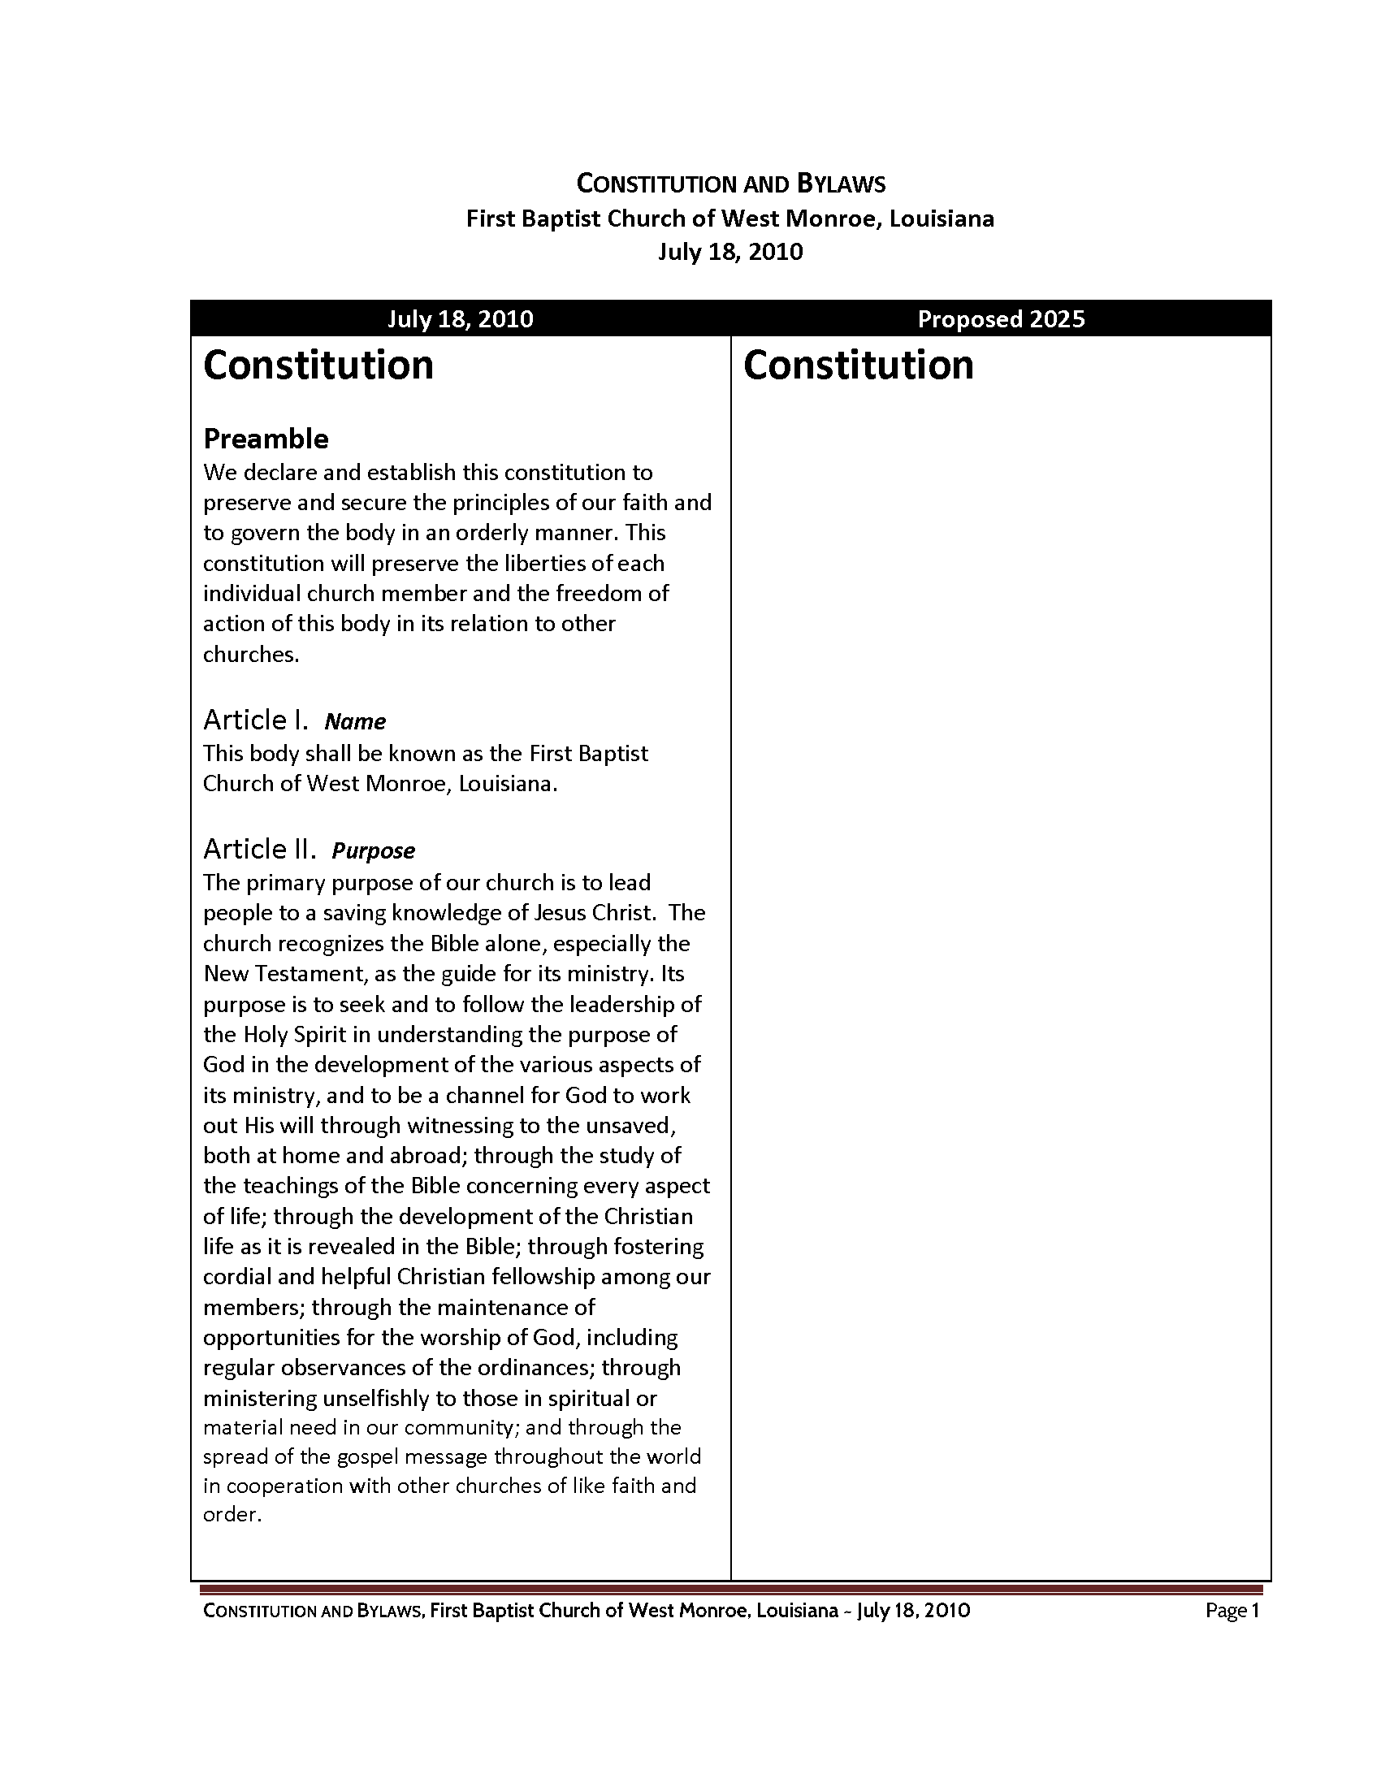

Slide 71
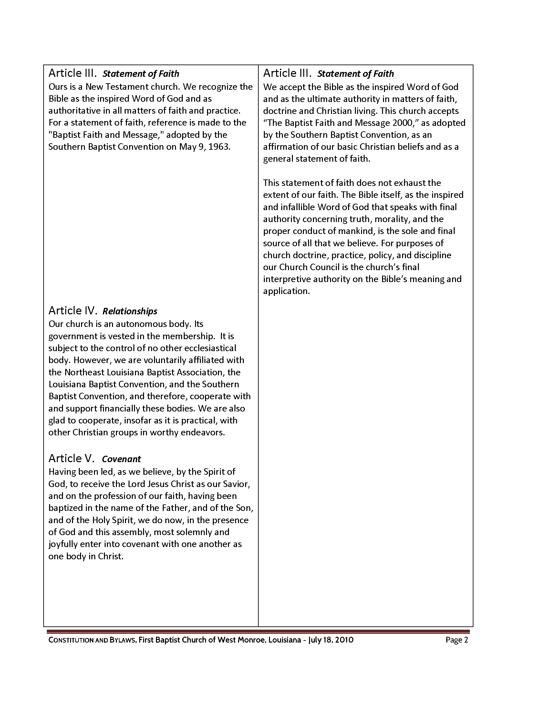

Slide 72
Constitution/Bylaws & Admin.
TAB 7
First West 2025 Constitutional Amendment* (4 pages)
Statement of Faith and Doctrine
Final Interpretive Authority
First West 2015 Bylaw Revisions Overview* (3 pages)
Membership
Church Discipline
Pastor Search Process
Ministerial Staff
Deacons
Trustees
Committees
Regular Meetings
Quorum

Slide 73
Constitution/Bylaws & Admin.
TAB 7
Admin & Tax Forms Summary* (3 pages)
Forms & Documents Summary* (2 pages)

Slide 74
Keeping Your Church Out of Court
TAB 8
by Texas Baptists
Church Organization and Operation
Church Liability for Personal Injury and Property Damage Claims
Decision Makers: Liability and Protection
Employment Law
Taxes and Governmental Compliance
Intellectual Property

Slide 75
Keeping Your
Church
Out of Court

